Slide 1
Causal Inference
Notes – Jose Parreño Garcia

Slide 2
Intro

Slide 3
Intro to causality

Slide 4
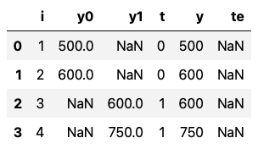
If we could measure in a parallel reality the same school, with the same students, taking the same exam, but under 2 different educational methods, what would the difference in exams results be?
Causality is built upon the concept of counterfactuals
School
School results before treatment
School results after treatment
Treatment
School results after treatment
Treatment effect
i
Different schools will be treated with a different educational methodology
y0
The school results before receiving treatment. You can see how we don’t know the results of schools 3 and 4.
y1
The school results after receiving treatment. You can see how we don’t know the results of schools 1 and 2.
t
Did the school receive a new educational methodology treatment? (0 = no, 1 = yes)
y
Final school results after treatment. y would be the same as y1.
te
The causal effect of having treated or not a school. In this case, we have NAs, because:
We can’t compare with the results after being for schools 1 & 2
We can’t compare with the results before being for treated for schools 3 & 4

Slide 5
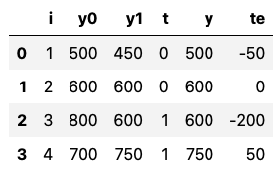
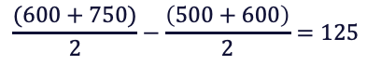
If we said that the new education system is working with tablets, then one could argue that schools 3 & 4 have better grades, not because of the new system, but because:
Schools with tablets => wealthy families => more time to study => even without tablets, they would still achieve better grades!
Causality suffers from bias
Association $≠$ Causation
If we don’t try to predict counterfactuals, based on the results, we might say that, those schools with the new education system benefitted from it… (the association eq. below says that 125 points better)
… But assume we had true data like the one below, then we would actually be wrong! The schools 3 & 4 actually had better grades before being treated!
$$Association=E\left[Y | T=1\right]−E\left[Y | T=0\right]$$
Average test score for treated schools minus average test score for untreated schools
$$\frac{(600+750)}{2}−\frac{\left(500+600\right)}{2}=125$$
Which is wrong!

Slide 6
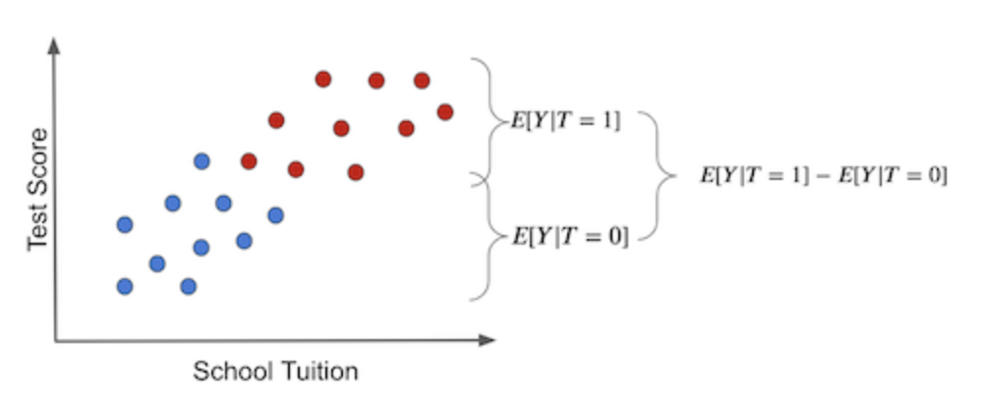
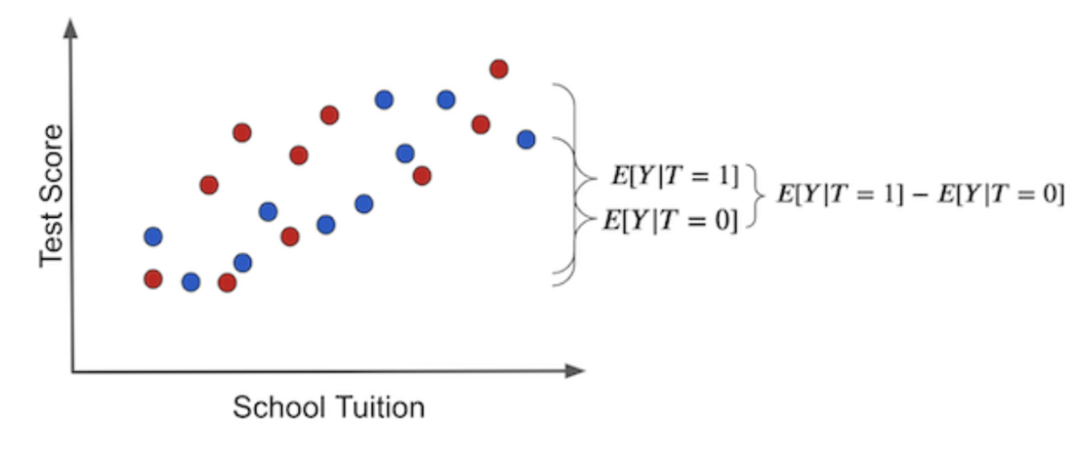
Untangling association and causation
Graphical form
Blue dots: schools without tablets
Red dots: schools with tablets
School tuition: 3rd variable we haven’t accounted for
The difference in outcomes between the two groups can have two causes:
The treatment effect. The increase in test score that is caused by giving kids tablets.
Other differences between the treatment and untreated that are NOT the treatment itself. In this case, treated and untreated differ in the sense that the treated have a much higher tuition price. Some of the difference in test scores can be due to the effect of tuition price on better education.
In this case, the difference in the outcome between treated and untreated IS the average causal effect.
This happens because there is no other source of difference between treatment and untreated other than the treatment itself.
All the differences we see must be attributed to it.
Another way to say this is that there is no bias.

Slide 7
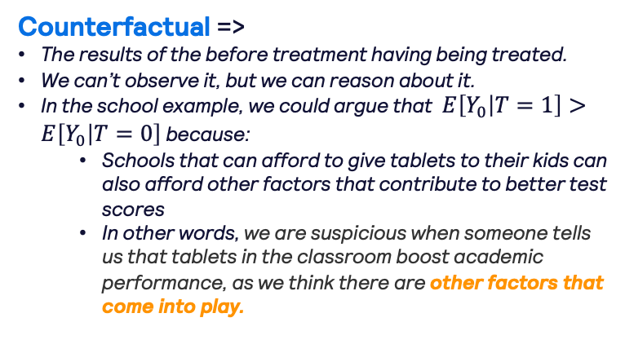
Untangling association and causation
Bias => how the treated (T=1) and control (T=0) group differ before the treatment (Y₀), that is, in case neither of them has received the treatment.
Mathematical form
$$Association=E\left[Y | T=1\right]−E\left[Y | T=0\right]=E\left[Y_{1}−Y_{0} | T=1\right]+(E\left[Y_{0} | T=1\right]−E\left[Y_{0} | T=0\right])$$
Causation => a.k.a. ATET => Average Treatment Effect of the Treated => how the treated group (T=1) differs before (Y₀) and after (Y₁) the treatment.
Counterfactual =>
The results of the before treatment having being treated.
We can’t observe it, but we can reason about it.
In the school example, we could argue that $E\left[Y_{0} | T=1\right]>E\left[Y_{0} | T=0\right]$ because:
Schools that can afford to give tablets to their kids can also afford other factors that contribute to better test scores
In other words, we are suspicious when someone tells us that tablets in the classroom boost academic performance, as we think there are other factors that come into play.
Other factors that come into play => Confounders
Tuition cost
Teachers
Location
Etc

Slide 8
Master diagram of Causal Inference methods

Slide 9
Interrupted time series synthetic control DiD
Master diagram
Yes
More than a handful of observations before and after intervention?
No
Difference in Difference
Yes
Have control time series data from a non-treated unit?
Interrupted time series without control
Yes
No
Repeated observations of the outcome over time?
Regression Discontinuity
No
Yes
Treatment assignment depends on a sharp cut-off?
Instrumental Variables
No
Regression
Confounders
(Good, Bad)
Have a third variable associated with the outcome only though the cause variable?
Yes
No
Propensity Score Matching
Doble Robust Estimation

Slide 10
Other areas of focus in Causal Inference

Slide 11
Heterogenous treatment effects (elasticity)
Evaluation of causal models
How to use ML for causal inference
Meta learners
The S-learner
The T-learner
The X-learner
The R-learner

Slide 12
Part I

Slide 13
Regression
Linear regression
Grouped and dummy regression
Confounding variables and omitted bias

Slide 14
Interrupted time series synthetic control DiD
Master diagram
Yes
More than a handful of observations before and after intervention?
No
Difference in Difference
Yes
Have control time series data from a non-treated unit?
Interrupted time series without control
Yes
No
Repeated observations of the outcome over time?
Regression Discontinuity
No
Yes
Treatment assignment depends on a sharp cut-off?
Instrumental Variables
No
Regression
Confounders
(Good, Bad)
Have a third variable associated with the outcome only though the cause variable?
Yes
No
Simple matching
Propensity Score Matching
Doble Robust Estimation

Slide 15
Linear Regression The work horse of causal inference

Slide 16
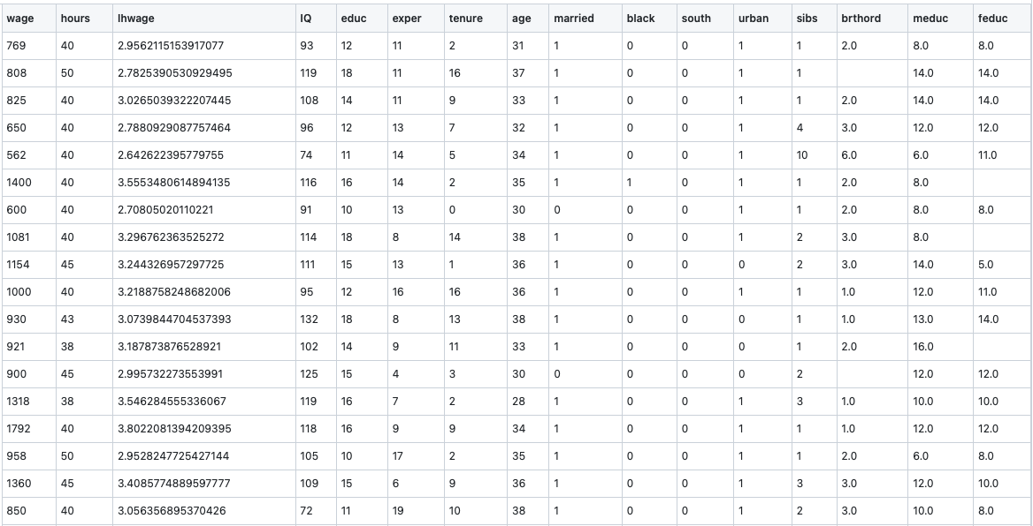
Dataset Example: wages & education
What: Non-random data (ie, no controlled group as part of this observational data – you cant simply randomise people to study 8 or 12 years)
Goal: Estimate the impact of an additional year of education on hourly wage
lhwage: log hourly wage
educ: years of education
meduc: education of mother
feduc: education of father
IQ: IQ for that person
age: age of that person
exper: number of years of experience
tenure: years of experience at current company
Dummy variables for marriage and ethnicity and other variables

Slide 17
Causal graph approach
Naïve approach
Realistic approach
Here we believe that the ONLY thing that affects hourly wages is the number of educational years someone has had.
The more you study, the higher the hourly salary.
Now, whilst we do believe there must be an effect of education on wage, it can’t be the only -> there must ALSO be other CONFOUNDING factors that come into play.
Feduc
IQ
Educ
Educ
Meduc
Hr wage
Hr wage
Knowing that domain knowledge of the problem will be key to success, let’s explore how to transform this conceptual mapping to a regression problem and establish valid effects on X on Y.

Slide 18
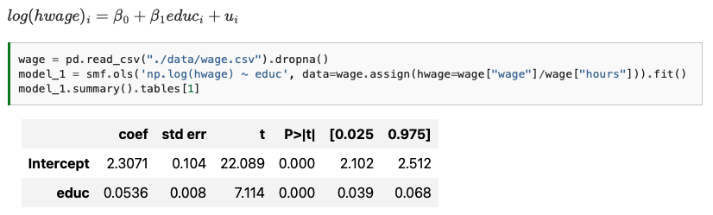
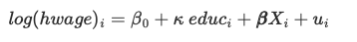
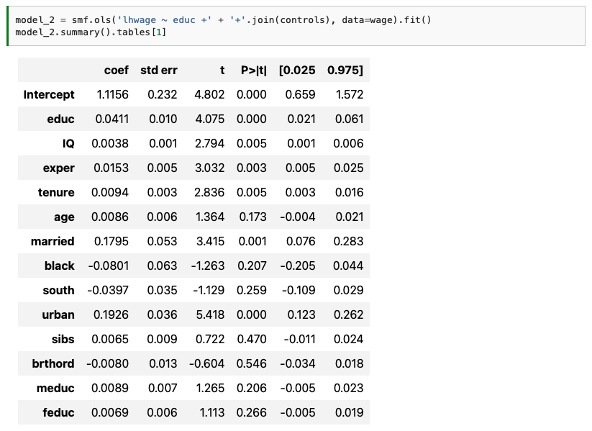
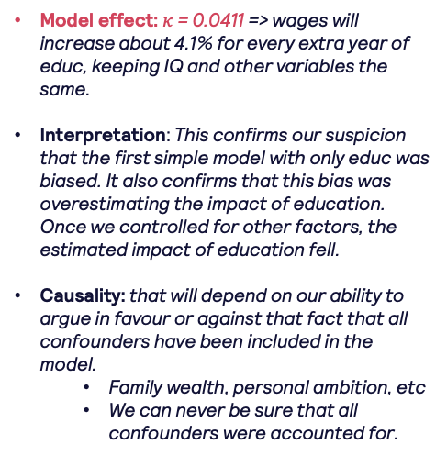
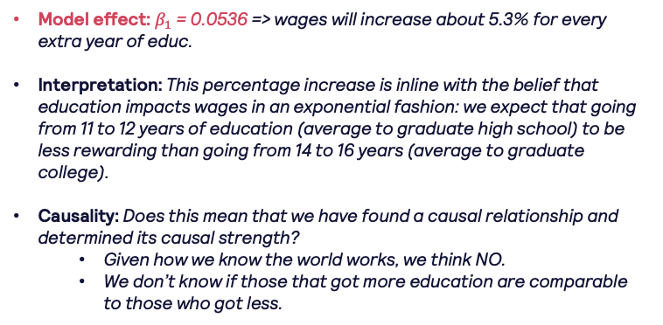
Feduc
Regression approach
IQ
Educ
Meduc
Educ
Hr wage
What we can do is include ‘control’ variables in our regression model. Remember that in regression, each coefficient is the effect on the target HOLDING the other variables constant.
Naïve approach
Realistic approach
Hr wage
Model effect: $κ$= 0.0411 => wages will increase about 4.1% for every extra year of educ, keeping IQ and other variables the same.
Interpretation: This confirms our suspicion that the first simple model with only educ was biased. It also confirms that this bias was overestimating the impact of education. Once we controlled for other factors, the estimated impact of education fell.
Causality: that will depend on our ability to argue in favour or against that fact that all confounders have been included in the model.
Family wealth, personal ambition, etc
We can never be sure that all confounders were accounted for.
Model effect: $β_{1}$ = 0.0536 => wages will increase about 5.3% for every extra year of educ.
Interpretation: This percentage increase is inline with the belief that education impacts wages in an exponential fashion: we expect that going from 11 to 12 years of education (average to graduate high school) to be less rewarding than going from 14 to 16 years (average to graduate college).
Causality: Does this mean that we have found a causal relationship and determined its causal strength?
Given how we know the world works, we think NO.
We don’t know if those that got more education are comparable to those who got less.
Btw, good practice is to re-run a model without non-significant features

Slide 19
Grouped Regression What to do when you don’t have granular data?

Slide 20
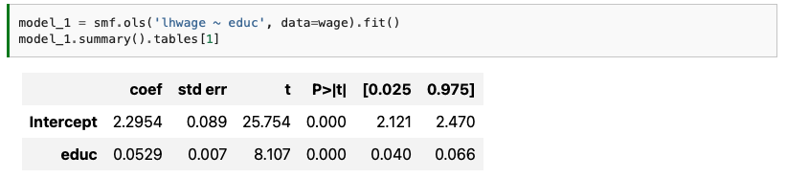
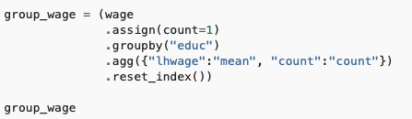
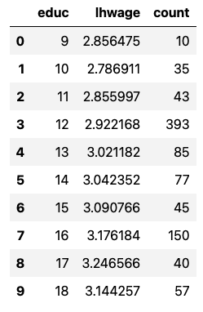
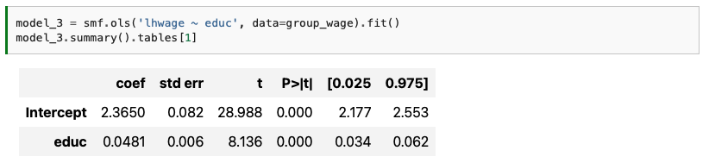
Dataset Example: wages & education -> grouped data
What (I): Non-random data (ie, no controlled group as part of this observational data – you cant simply randomise people to study 8 or 12 years)
What (II): Imagine that we don’t have individual data, but GROUPED data.
Goal: Estimate the impact of an additional year of education on hourly wage -> ungrouped or grouped data SHOULD reflect the same effects
Leaving aside bias, if we run a regression model to figure out how education is associated with log hourly wages, we get the following result.
What (I)
What would happen if we only take aggregated data and run the same regression model?
Regression is placing equal weight for all points. Ie, those buckets with only 10 records in them are equally important to those with 393 records in them.
We can see how the coefficients differ, and they really shouldn’t.
What (II)
HOW TO FIX THIS? -> WLS

Slide 21
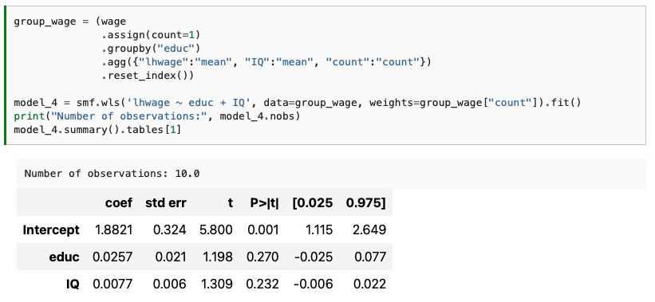
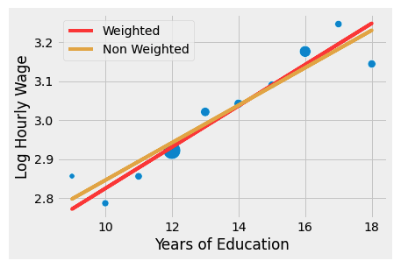
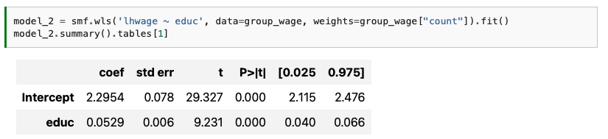
Bonus: Weighted Least Squares including covariates
The only thing to consider to which aggregated function to use for the covariate. In this example, we take the average IQ, but it could be median, sum, std…
Weighted Least Squares (WLS)
The raw and weighted grouped regression provide very similar results
Regression is weighted by the number of records
If not accounted for, regression will fit for the noise in the smaller sample buckets
The size of each dot represents the number of records representing that data point.
You can observe how the weighted fit goes much closer to the points with bigger ‘weights’ or bigger ‘representative’ counts

Slide 22
Dummy Regression Adding categories or cut-offs points to our data.

Slide 23
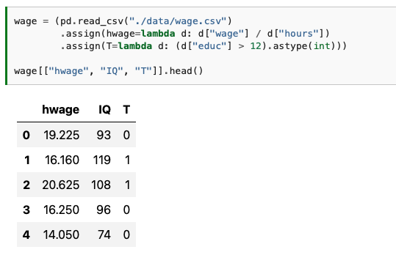
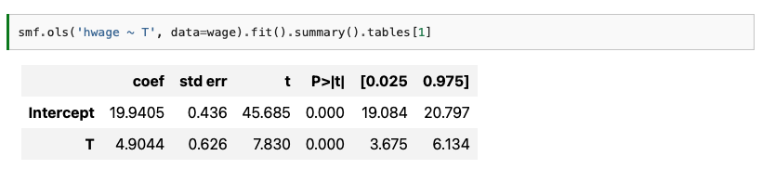
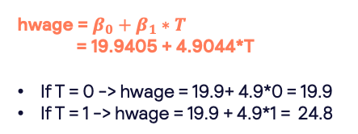
Case 1: Binary Treatment effect
What is the effect of graduating on 12th grade on hourly wage?
Treatment
T=1 -> graduation after 12th
T=0 -> graduation before 12th
What we have done is binarized a semi-continuous variable -> it’s like a switch for a regression model
hwage = $β_{0}+β_{1}∗T$
= 19.9405 + 4.9044*T
If T = 0 -> hwage = 19.9+ 4.9*0 = 19.9
If T = 1 -> hwage = 19.9 + 4.9*1 = 24.8
The dummy coefficient captures the difference in means between the treated and untreated.
More formally, when the independent variable is binary, as is often the case with treatment indicators, regression captures the ATE perfectly.

Slide 24
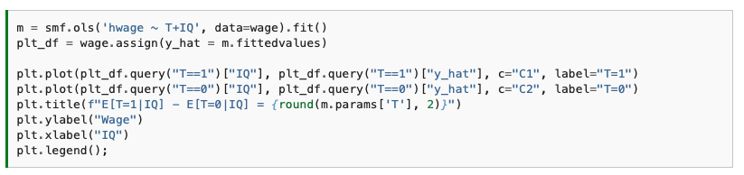
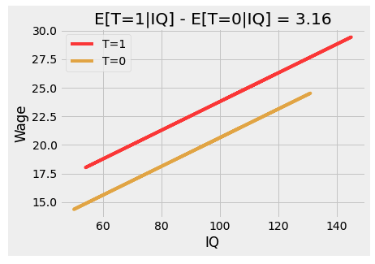
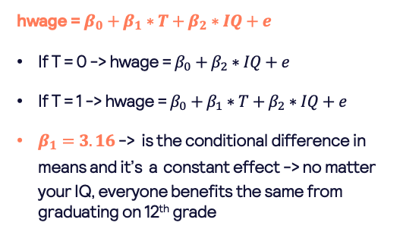
Case 2: Binary Treatment effect + additional variables
What is the effect of graduating on 12th grade on hourly wage considering IQ too?
Treatment
T=1 -> graduation after 12th
T=0 -> graduation before 12th
If we use additional variables, the dummy coefficient becomes the conditional difference in means.
Now, the dummy coefficient tells us how much increase we should expect from graduating 12th grade while holding IQ fixed.
hwage = $β_{0}+β_{1}∗T+β_{2}∗IQ+e$
If T = 0 -> hwage = $β_{0}+β_{2}∗IQ+e$
If T = 1 -> hwage = $β_{0}+{β_{1}∗T+β}_{2}∗IQ+e$
$β_{1}=3.16$ -> is the conditional difference in means and it’s a constant effect -> no matter your IQ, everyone benefits the same from graduating on 12th grade
When we hold IQ fixed, 3.16 is the difference we expect in wage for those who graduated before or after 12th grade.

Slide 25

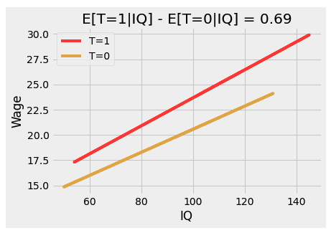
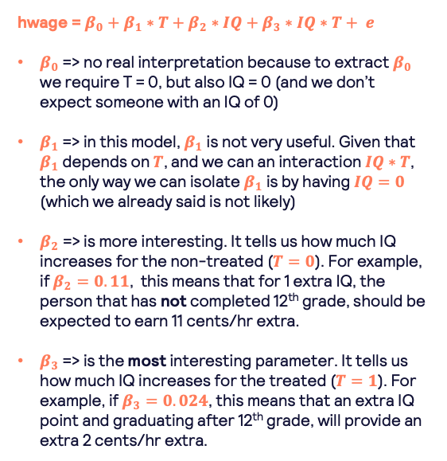
Case 3: Binary Treatment effect interacted with additional variables
What is the effect of graduating on 12th grade on hourly wage depending also on your level of IQ?
Treatment
T=1 -> graduation after 12th
T=0 -> graduation before 12th
When we interact our treatment variable with another confounder, we are allowing the regression model to understand a heterogeneous treatment effect (ie, different for different ‘cases’)
hwage = $β_{0}+β_{1}∗T+β_{2}∗IQ+β_{3}∗IQ∗T+ e$
$β_{0}$ => no real interpretation because to extract $β_{0}$ we require T = 0, but also IQ = 0 (and we don’t expect someone with an IQ of 0)
$β_{1}$ => in this model, $β_{1}$ is not very useful. Given that $β_{1}$ depends on $T$, and we can an interaction $IQ∗T$, the only way we can isolate $β_{1}$ is by having $IQ=0$ (which we already said is not likely)
$β_{2}$ => is more interesting. It tells us how much IQ increases for the non-treated ($T=0$). For example, if $β_{2}=0.11$, this means that for 1 extra IQ, the person that has not completed 12th grade, should be expected to earn 11 cents/hr extra.
$β_{3}$ => is the most interesting parameter. It tells us how much IQ increases for the treated ($T=1$). For example, if $β_{3}=0.024$, this means that an extra IQ point and graduating after 12th grade, will provide an extra 2 cents/hr extra.
Due to the interaction between treatment and IQ, we see that the lines are no longer parallel => those graduating after 12th grade have a higher slope on IQ, and benefit more on hourly wage

Slide 26
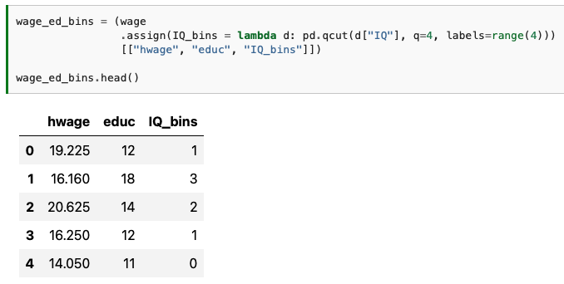
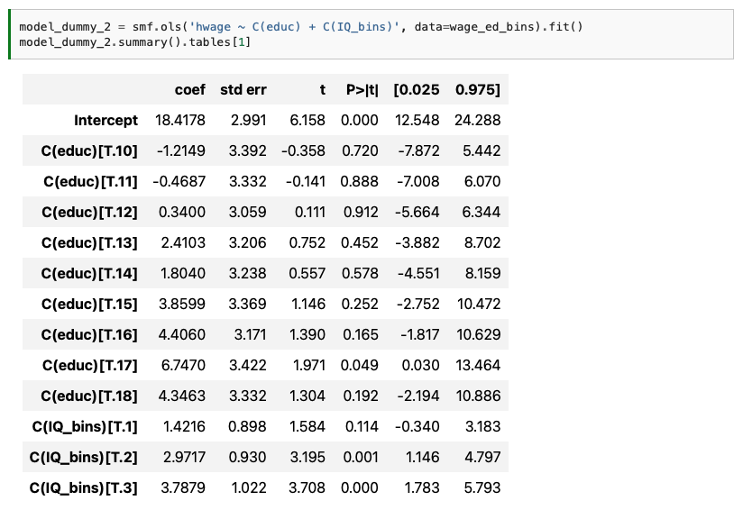
Case 4: to the extreme -> all variables as categorical treatments
Instead of having a single cutoff point, we allow each year of education to be it’s own treatment. We also bucketize IQ and let each bucket act as it’s own treatment…
Treatment
Whilst it seems a great idea to have lot’s of flexibility and that we don’t have to predefined our ‘hypothesis’, it does come with a big drawback.
The vast majority of coefficients are not statistically significant
You can’t just simply blindly throw whatever we can measure to the model!!
So the question is, which do we know are good controls to include in our causal model?

Slide 27
Confounders
How to identify good or bad ones

Slide 28
Interrupted time series synthetic control DiD
Master diagram
Yes
More than a handful of observations before and after intervention?
No
Difference in Difference
Yes
Have control time series data from a non-treated unit?
Interrupted time series without control
Yes
No
Repeated observations of the outcome over time?
Regression Discontinuity
No
Yes
Treatment assignment depends on a sharp cut-off?
Instrumental Variables
No
Regression
Confounders
(Good, Bad)
Have a third variable associated with the outcome only though the cause variable?
Yes
No
Simple matching
Propensity Score Matching
Doble Robust Estimation

Slide 29
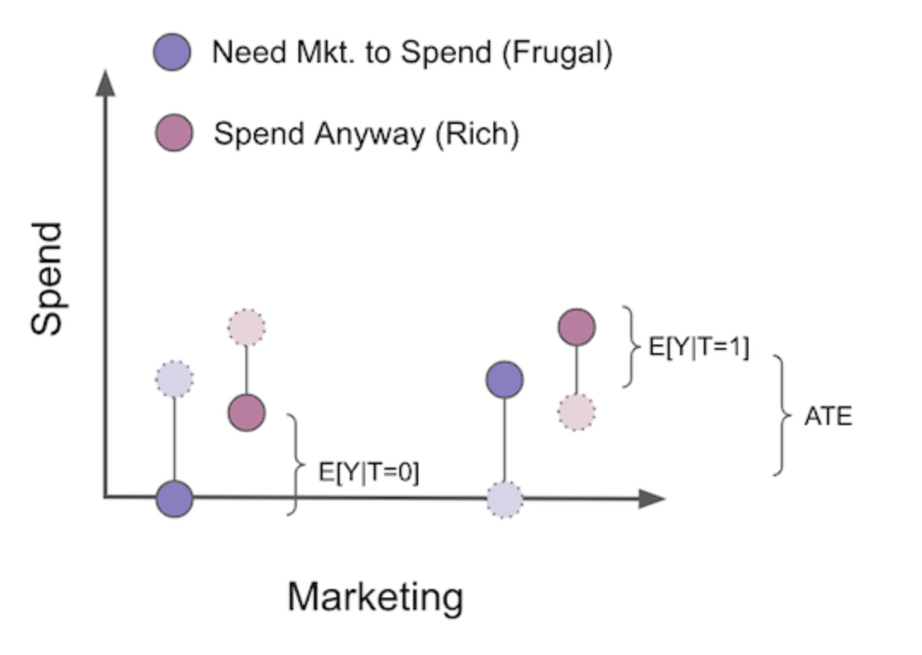
Email
Credit
Risk
severity
Rule of thumb
Treatment
Pay
Days
Always add the treatment
If a variable is a good predictor of the outcome (even if it is not a confounder), then add it to the model to control for it (because they lower the variance of our treatment estimates)
If a variable is also correlated with the treatment, then clearly add it! (because not only it lowers the variance of our treatment estimate, it also helps explain treatment effects)
Do NOT add controls that are JUST good predictors of the treatment.
Avoid selection bias as much as possible.
severity
hospital
Treatment
Days
Email
credit
risk
opened
agreement
Pay

Slide 30
Treatment + Good controls Good controls help reduce variance in the measurement of the treatment effect

Slide 31
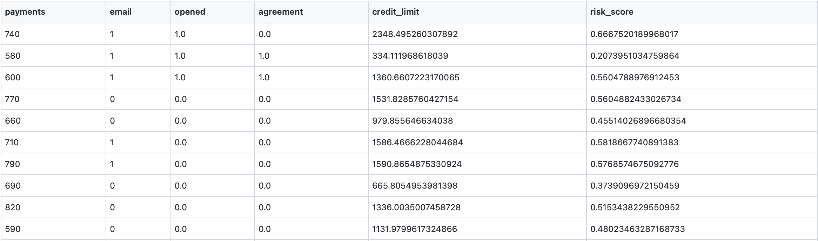
Dataset Example: prompting users to pay their debt
What: 5000 random customers from your late customers base to do a random test
Goal: figure out the impact of sending an email asking people to negotiate their debt.
payments: payment amount
email: did the user receive the email or not (treatment)
opened: did the user open the email
agreement: if the customers contacted the collections department to negotiate their debt, after having received the email.
credit_limit: customer’s credit line prior to he or she getting late
risk_score: estimated risk of the customer prior to the delivery of the email

Slide 32
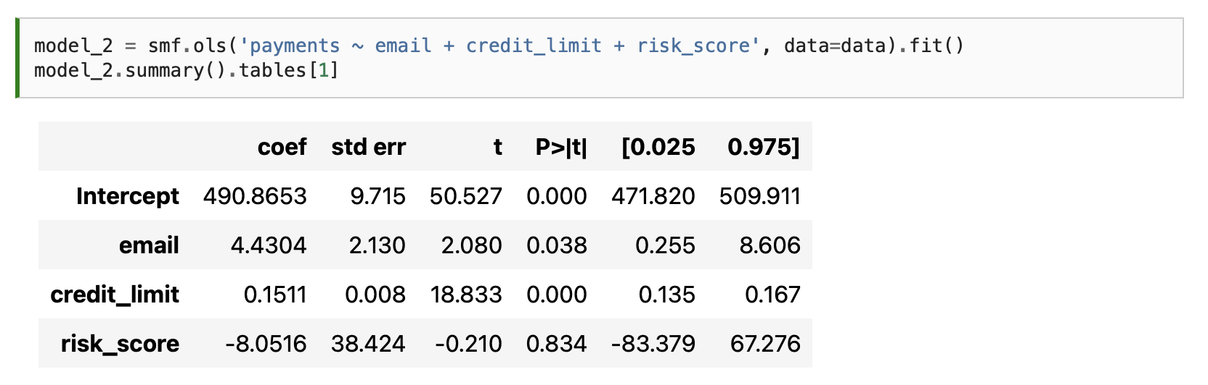
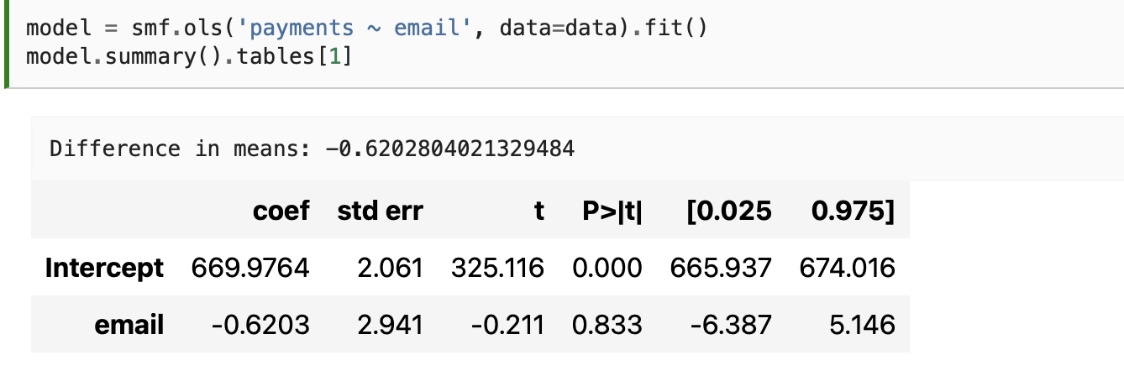
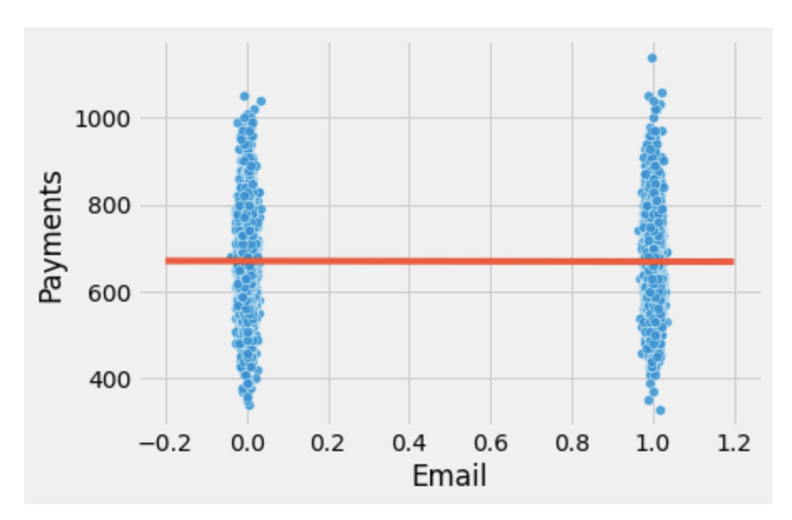
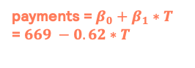
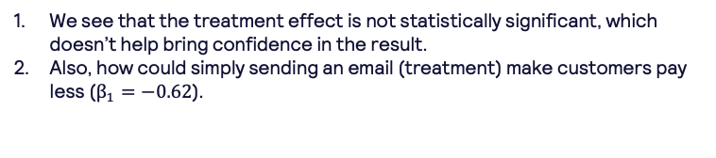
Regression approach
GOOD CONTROLS?… Well, we know that people tend to make payments when their financial help is healthy, therefore, it makes sense to look at other control variables that can help predict the outcome better…
Email
Credit
Risk
Pay
Email
Naïve approach
Realistic approach
Pay
payments = $β_{0}+β_{1}∗T$
= $669 −0.62∗T$
We see that the treatment effect is not statistically significant, which doesn’t help bring confidence in the result.
Also, how could simply sending an email (treatment) make customers pay less ($β_{1}=−0.62$).
payments = $β_{0}+β_{1}∗T+β_{2}∗credit{+ β}_{3}∗risk=. 490+4.4∗T+0.15∗credit−8∗risk$
Why are credit and risk GOOD controls? If a variable is a good predictor of the outcome, it will explain away a lot of its variance. If risk and credit limit are good predictors of payment, we can control them to make it easier to find the impact of the email on payments. If risk and credit line predicts payments very well, customers with a similar risk and credit line should also have similar payment levels, hence with less variance.
Having ‘controlled’ for credit and risk, we can now understand that the treatment (sending an email) does increase the chances of repayments by 4.4 units.
You can see how the variance in the target variable for each of the 2 treatment groups is SUPER big.
This is basically, a reflection of the high p-value and the big confidence interval. In essence, the treatment on it’s own doesn’t seem to be very good a differentiating effects on the target.
Notes:
Question: risk_score is not statistically significant.
In a model I would take it out
But, for causality, if it helps reduce variance to understand the treatment effect, should we include it?

Slide 33
Treatment + Bad controls – Selection bias Controls that are directly affected by the treatment and are in the direct path between treatment and effect are bad controls.

Slide 34
Continuing with the email example…
There are still extra variables (controls) that we might want to try in our model…
Email
credit
risk
Treatment: email: we know nothing else causes the treatment, because it is random by design. We also think it must have some effect on the target.
Good Controls: credit and risk. We also have strong reasons to believe that these controls cause payments.
What about opened and agreement?
We believe it can cause payments. Intuitively, people that opened the collection email could be more willing to negotiate and pay their debt as they are already prone to opening an email related with payments.
We believe that opened also causes agreement. Similar to above, if someone opens and email, their chances of trying to reach an agreement might increases.
We believe agreement causes payments. Idem to the above.
In addition, depending on credit and risk, some people will have different propensities of opening an email and agreeing on payment settlements.
opened
agreement
WHATS THE PROBLEM? THAT OPENED AND AGREEMENT ARE IN THE CAUSAL PATH FROM EMAIL TO PAYMENTS!
Suppose that we add agreement to our regression model, ie, suppose that we are controlling for ‘agreement’. This means that the treatment is no longer comparable across all controls, because one of them (agreement) is in the causal path (in other words, one control is a consequence of the treatment itself).
Pay
$$E\left[Y_{0} | T=0, Agreement=0\right]>E\left[Y_{0} | T=1, Agreement=0\right]?$$
$$E\left[Y_{0} | T=0, Agreement=1\right]>E\left[Y_{0} | T=1, Agreement=1\right]?$$
(1) No email or contacting to agree
(2) Having received the email but not contacting to agree
(3) No email but agreeing to pay
(4) Receiving the email and agreeing to pay
We have basically, eliminated the possibility to make a direct relationship between treatment and effect, because of variables which are directly affected by the treament
If we take the case were we are recovering payments, we would prefer those users who pay without having us to prompt them (1) vs (2)
If we take the case were we are recovering payments, we would prefer those users who pay agree to pay back without having us to prompt them (3) vs (4)

Slide 35
Treatment + Bad controls – those that are just good predictors of the treatment

Slide 36
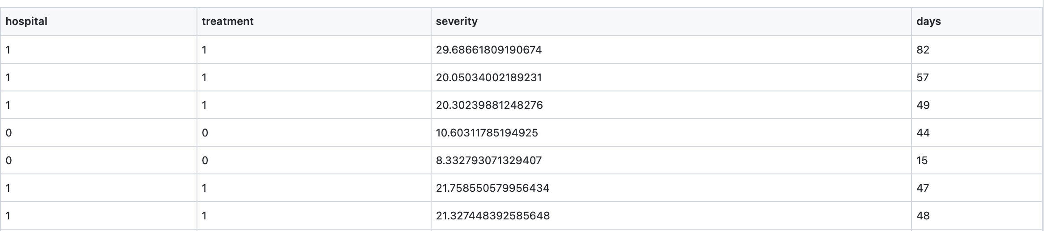
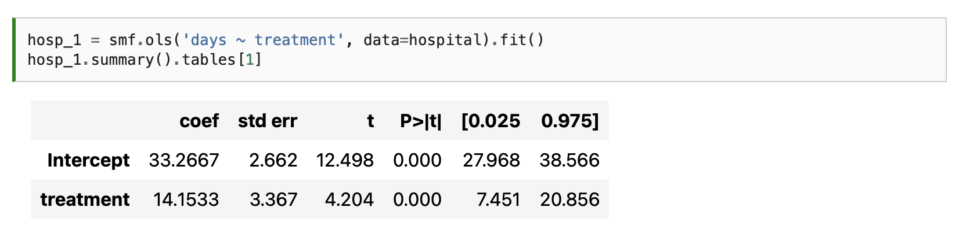
Hospital dataset
Hospital 1: 90% of the true drug and 10% of placebo. It also gets more severe cases of the illness to treat.
Hospital 0: 10% of the true drug and 90% of placebo.
What: data from 2 different hospitals.
Goal: days hospitalised. If the treatment is effective, it will lower the amount of days the patient stays in the hospital.
hospital: hospital ID
treatment: did a patient receive the drug (1) or placebo (0)
severity: severity score of case
days: days spent in hospital during treatment
So, as we have done before, our first instinct is to simply regress the treatment to the target outcome to understand its effect…
and surprisingly, we see that $β_{1}=14.15$, which means that the treatment actually increases the stay in hospital by 14 days!
How can this be possible? Well, we have seen that we might be missing information (omitted bias) which we need to control for by adding new features to our model.

Slide 37
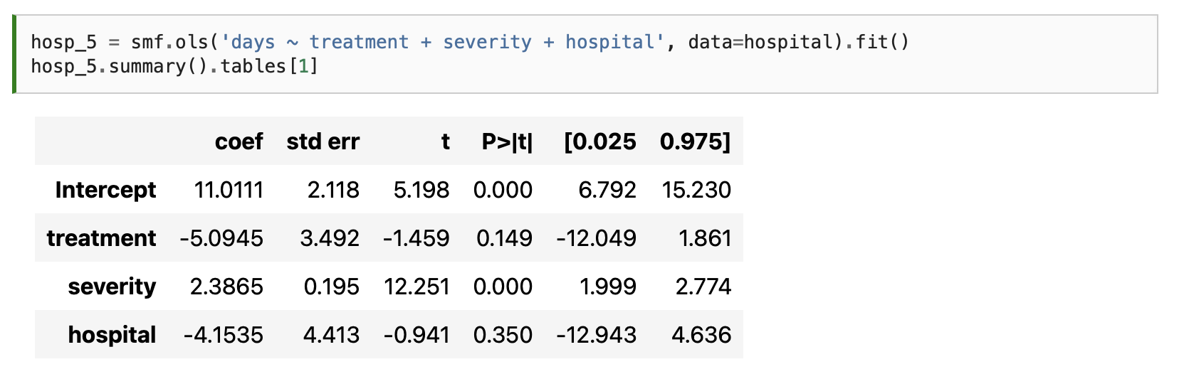
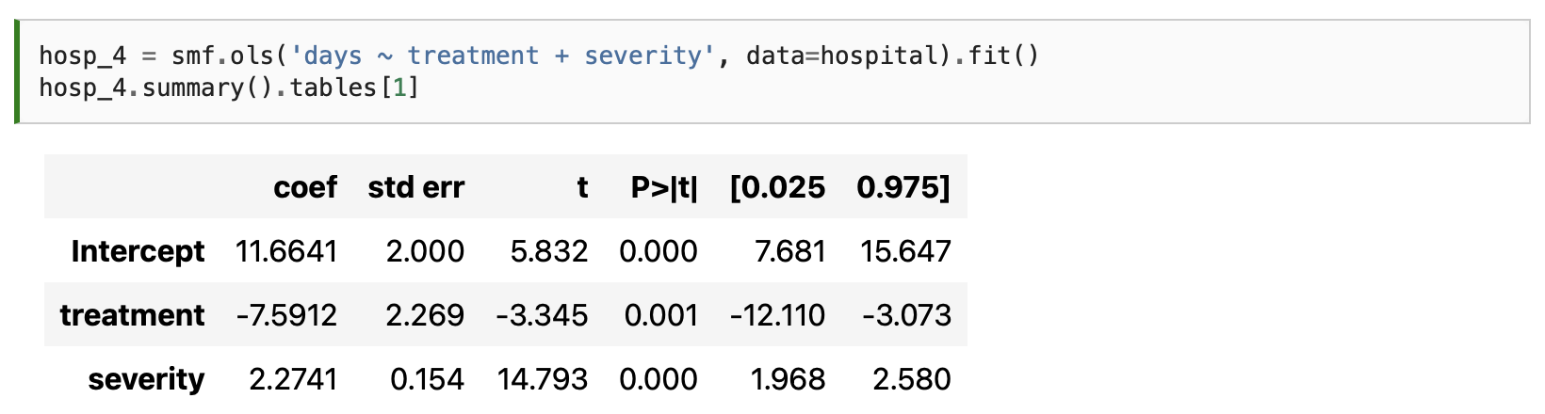
Regression approach
severity
hospital
severity
Treatment
Treatment
Good controls
Days
Days
Bad controls
days = $β_{0}+β_{1}∗T+β_{2}∗severity=11.6−7.6∗T+2.3∗severity$
days = $β_{0}+β_{1}∗T+β_{2}∗severity +β_{3}∗hospital=11 −5∗T+2.4∗severity−4.1∗hospital$
Now these results make much more sense:
Treatment decreases the number of days in hospital by 7 days
Severity acts the opposite, the higher the severity, the longer you will stay in hospital.
This is an example of good control:
Severity predicts well the outcome -> as a by product, it also reduces variances for the treatment.
Severity is also correlated with the treatment -> it is fine to include this because there might be still some information to estimate days that has to come from the combination of both severity and treatment.
By controlling for severity, we now are able to untangle the different types of populations in different hospitals.
Maybe hospital 0 was a small one, and the segment of the population being treated there is different to the big urban hospital 1 -> the effects of the treatment cannot be compared equally in both populations unless we control for severity.
Who would have thought that by controlling for hospital, we would be harming the causal effect of our treatment? (now, treatment is not statistically significant and introduced more variance to our estimated effect - ATE)
Why is hospital such a bad control?
Once we control for severity , hospital is a good predictor of the treatment and not of the outcome.
We should NOT add controls that are just good predictors of the treatment, because they will increase the variance of our estimates.

Slide 38
Treatment + Bad controls – Selection bias – the Bad COP Think of it as a cannibalisation effect of your causality

Slide 39
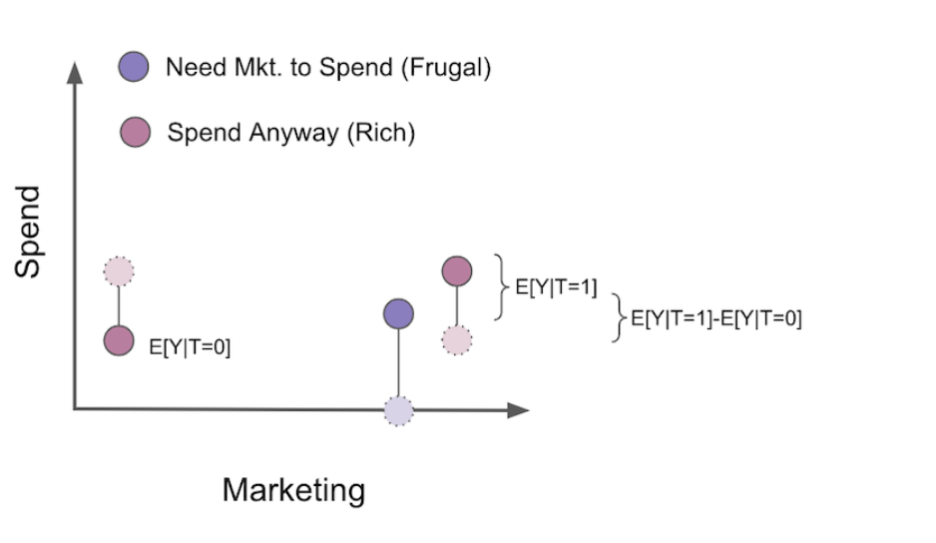
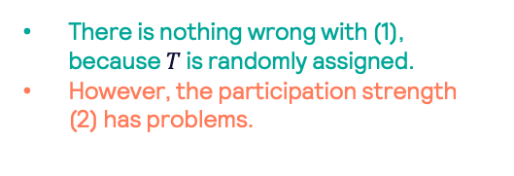
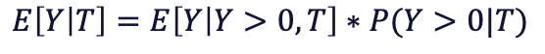
Bad COP => splitting your regression model into a participation rate and then, the amount of participation
Let’s say we are dealing with a marketing campaign. It has been randomized at a user level, so no worries with confounders (it’s like a randomised controlled trial).
We could about our population in 2 ways:
Those that spend regardless of our marketing efforts (although they do spend more if we prompt them)
Those that only spend if we prompt them.
As a data scientist, you believe it would be a good idea to model this problem in 2 chained models:
(1) A participation model
(2) A model that evaluates how much the spend will be (given participation based on (1))
$$E\left[Y | T\right]=E\left[Y | Y>0, T\right]∗P(Y>0|T)$$
There is nothing wrong with (1), because $T$ is randomly assigned.
However, the participation strength (2) has problems.
(2) Participation strength. Having determined they will participate due to marketing prompt, how much will they buy
(1) Participation model. If we prompt them with marketing, will they buy
What happens with (2), is that because we are only seeking those who would spend money, for the untreated group (those who wouldn’t be exposed to our marketing effect), is left only with the segment of the population which would have spent money even without our treatment.
‘ideal’ counterfactuals
As a result, once we filter only the participant population, our estimate of the ATE becomes biased, even if there was no bias at first due to randomization.
Next slide will show the same effect but under a mathematical formulation…

Slide 40
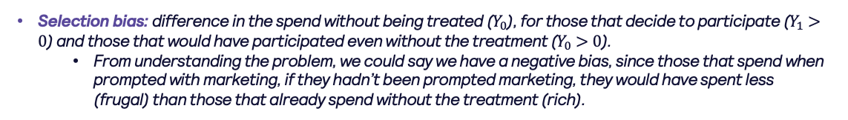

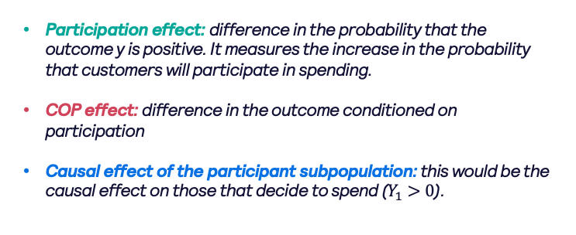
Bad COP => splitting your regression model into a participation rate and then, the amount of participation
As a data scientist, you believe it would be a good idea to model this problem in 2 chained models:
(1) A participation model
(2) A model that evaluates how much the spend will be (given participation based on (1))
$$E\left[Y | T\right]=E\left[Y | Y>0, T\right]∗P(Y>0|T)$$
There is nothing wrong with (1), because $T$ is randomly assigned.
However, the participation strength (2) has problems
‘ideal’ counterfactuals
(2) Participation strength. Having determined they will participate due to marketing prompt, how much will they buy
(1) Participation model. If we prompt them with marketing, will they buy
$$E\left[Y | T\right]=ATE=E\left[Y | T=1\right]−E\left[Y | T=0\right]$$
$E\left[Y | T\right]=E\left[Y | Y>0, T=1\right]∗P(Y>0|T=1)$ - $E\left[Y | Y>0, T=0\right]∗P(Y>0|T=0)$
Participation effect
$$E\left[Y | T\right]=E\left[Y | Y>0, T=1\right]∗\left(P\left(Y>0 | T=1\right)−P\left(Y>0 | T=0\right)\right)$$
COP effect
$$E\left[Y | T\right]=+\left(E\left[Y | Y>0,T=1\right]−E[Y|Y>0,T=0]\right)∗P(Y>0|T=0)$$
Breaking down the COP effect…
Participation effect: difference in the probability that the outcome y is positive. It measures the increase in the probability that customers will participate in spending.
COP effect: difference in the outcome conditioned on participation
Causal effect of the participant subpopulation: this would be the causal effect on those that decide to spend ($Y_{1}>0$).
$$\left(E\left[Y | Y>0,T=1\right]−E[Y|Y>0,T=0]\right)=…=E\left[Y_{1}−Y_{0} | Y_{1}>0\right]+(E\left[Y_{0} | Y_{1}>0\right]−E\left[Y_{0} | Y_{0}>0\right])$$
(2.1) Causal effect
(2.2) Selection bias
Selection bias: difference in the spend without being treated ($Y_{0}$), for those that decide to participate ($Y_{1}>0$) and those that would have participated even without the treatment ($Y_{0}>0$).
From understanding the problem, we could say we have a negative bias, since those that spend when prompted with marketing, if they hadn’t been prompted marketing, they would have spent less (frugal) than those that already spend without the treatment (rich).

Slide 41
Email
Credit
Risk
severity
Rule of thumb (repeat)
Treatment
Pay
Days
Always add the treatment
If a variable is a good predictor of the outcome (even if it is not a confounder), then add it to the model to control for it (because they lower the variance of our treatment estimates)
If a variable is also correlated with the treatment, then clearly add it! (because not only it lowers the variance of our treatment estimate, it also helps explain treatment effects)
Do NOT add controls that are JUST good predictors of the treatment.
Avoid selection bias as much as possible.
severity
hospital
Treatment
Days
Email
credit
risk
opened
agreement
Pay

Slide 42
Matching
Simple matching
Propensity score matching

Slide 43
Interrupted time series synthetic control DiD
Master diagram
Yes
More than a handful of observations before and after intervention?
No
Difference in Difference
Yes
Have control time series data from a non-treated unit?
Interrupted time series without control
Yes
No
Repeated observations of the outcome over time?
Regression Discontinuity
No
Yes
Treatment assignment depends on a sharp cut-off?
Instrumental Variables
No
Regression
Confounders
(Good, Bad)
Have a third variable associated with the outcome only though the cause variable?
Yes
No
Simple matching
Propensity Score Matching
Doble Robust Estimation

Slide 44
Simple matching Just another way of controlling for confounders

Slide 45
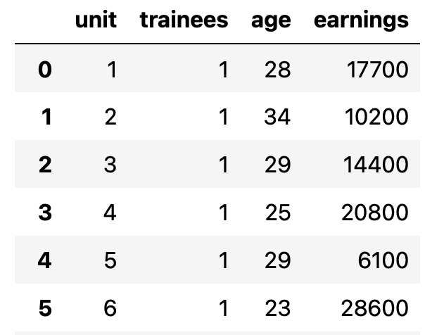
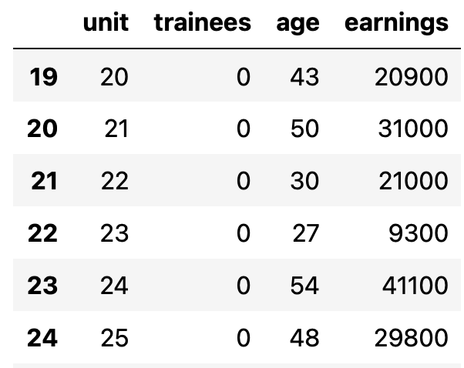
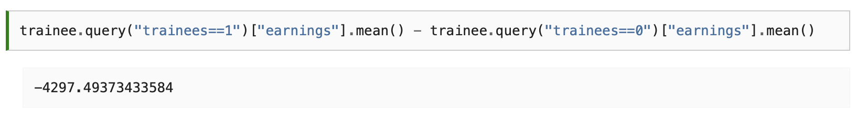
Scenario: what is the effect of a training problem in wages?
Imagine we are running a training program in our company. To the left you have data on those who take part of the program and those who don’t.
One would expect that those being trained will later have a reflection in performance improvement, and therefore, increased earnings.
Running a simple comparison in means, we get that the trainees earn less money than those that didn’t go through the program.
motivation
Training program
age
wage
Hold on... That doesn’t seem very intuitive right? What can be happening?
First, if we look at the tables above, we notice that trainees are much younger than non trainees, which indicates that age is probably a confounder.
We also know that the treatment (training program) is not randomly assigned, since employees enter by their own will, which means there might be hidden unmeasurable confounders like motivation.
It could be that only more motivated people do the training and they would have higher earnings regardless of the training.
How can matching help?
Since some sort of confounder X (motivation) makes it so that treated and untreated are not initially comparable, I can make them so by matching each treated unit with a similar untreated unit.
It is like I’m finding an untreated twin for every treated unit. By making such comparisons, treated and untreated become again comparable.
These twins can be matched using another known confounder(s) (for example, age)

Slide 46
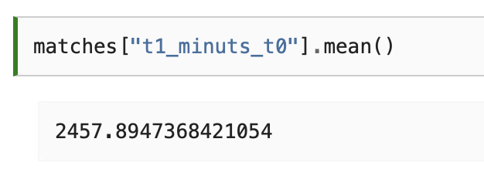
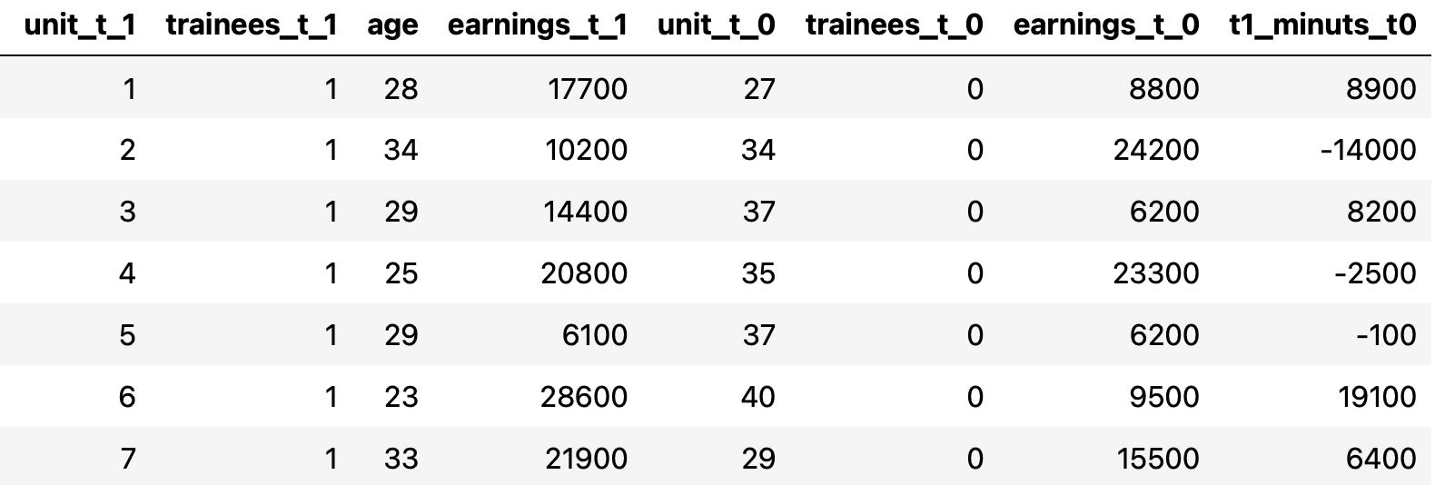
Perfect matching example
In reality, perfect matching doesn’t really exist, but it helps understand the method…
Method:
Pick a treated unit (say unit unit_t_1 = 1).
Look for an untreated unit with the same age (known confounder) (say unit_t_0 = 27, who is also 28 years old)
Do that for all treated units (by the way, untreated units can be repeated, see unit_t_0 = 37 appears twice).
With this, you have a dataset where, controlling for age, you can understand the effect on wages for treated and untreated units. (remember, we could have also done this in a regression setting)
Now, the effect is positive, ie, those attending the program will see a positive effect of 2457 points in their wages.
As mentioned, this is a super simple example, and in real life you have more than 1 confounder to control for (and they wouldn’t match perfectly…)
Also, in this example, we haven’t provided statistical estimated or confidence intervals…
But, you have understood the basics, which is the important bit.

Slide 47






A more complicated matching: using kNN or other clustering algo
mt0: will cluster the untreated population
Once again, we want to find the effect of a medication on days until recovery.
Unfortunately, this effect is confounded by severity, sex and age.
We have reasons to believe that patients with more severe conditions have a higher chance of receiving the medicine.
Below, you can see a dataset with scaled range of values for the possible confounders.
mt1: will cluster the treated population
based on the confounder characteristics of the treated, find the closest match based on the untreated clustering.
based on the confounder characteristics of the untreated, find the closest match based on the treated clustering.
Recovery value of the match
$$ATE=\frac{1}{N}\sum_{i=0}^{N}{(2T_{i}−1)(Y_{i}−Y_{jm}(i))}$$
$Y_{jm}(i)$ (“target match”) is the sample from the other treatment group which is most similar to $Y_{i}$ (“initial target”)
$2T_{i}−1$ is used to match both ways: treated with controls and controls with the treatment.
$N$ is simply all the records
Using this sort of matching, we can see that the effect of the medicine is not positive anymore. This means that, controlling for X, the medicine reduces the recovery time by about 1 day, on average.

Slide 48



With more complex matching comes bias
In the previous slide, we ran a kNN model to find matches between treatment groups, but we haven’t even checked if this model is doing a good matching job.
We are not going to get into understanding if a method provides good matching or not, but we know that, because the matching is not perfect, there will be bias in our estimation. Bias arises when the matching discrepancies are big.
Fortunately, there is a way we can mitigate this bias.
Each observation contributes $μ_{0}\left(X_{i}\right)−μ_{0}\left(X_{j}(i)\right)$ to the bias, so all we need to do is subtract this quantity from each matching comparison.
Sorry, what??...
We could do this manually, but the causalInference package already has an in-built bias adjustment method
$μ_{0}\left(X_{i}\right)$is the outcome $Y$ of a treated unit $i$ had it not been treated -> it is the counterfactual outcome$Y_{0}$for unit $i$.
$μ_{0}\left(X_{j}(i)\right)$is the outcome $Y$ of a untreated unit $j$ that is the match of unit $i$ -> it is the $Y_{0}$for unit $j$ -> which in this case is a factual outcome, because you are looking at an untreated ‘matched’ unit, so you know Y.
Now, because $j$ and $i$ are similar (not the same), the difference $μ_{0}\left(X_{i}\right)−μ_{0}\left(X_{j}(i)\right)$ will likely not be zero
In other words $Y_{0i}≈Y_{0j}$ but not $Y_{0i}=Y_{0j}$, and here is where we are introducing this biased noised.
Find 1 match using X between D groups, and adjust the bias
We can say with confidence that our medicine does indeed lower the time someone spends at the hospital.

Slide 49
Propensity score matching A way to avoid controlling for all possible confounders (be that through regression or matching algorithms)

Slide 50


How can a propensity score help?
Imagine we want to evaluate the impact of a ‘growth mindset’ in school success.
Intervention: students receive from the school a seminar to instil in them a growth mindset
schoolid: identifier of the student’s school
success_expect: self-reported expectations for success in the future, a proxy for prior achievement, measured prior to random assignment
ethnicity: categorical variable for student race/ethnicity
gender: categorical variable for student identified gender
frst_in_family: categorical variable for student first-generation status, i.e. first in family to go to college
school_urbanicity: school-level categorical variable for urbanicity of the school, i.e. rural, suburban, etc
school_mindset: school-level mean of students’ fixed mindsets, reported prior to random assignment, standardised
school_achievement: school achievement level, as measured by test scores and college preparation for the previous 4 cohorts of students, standardised
school_ethnic_minority: school racial/ethnic minority composition, i.e., percentage of student body that is Black, Latino, or Native American, standardised
school_poverty: school poverty concentration, i.e., percentage of students who are from families whose incomes fall below the federal poverty line, standardised
school_size: total number of students in all four grade levels in the school, standardised.
X
P(x)
It seems that the intervention had a significant positive effect of + 0.47 points in the achievement score… but, we already suspect this is biased (more ambitious people are more willing to go to the seminar, so they probably would have achieved more even if they had not attended it).
We could try to control for bias through regression or simple matching, but we will introduce propensity score matching.
T
Y
What is Propensity Score in the context of Y, T and X?
Propensity score comes from the realisation that you don’t need to directly control for confounders X to achieve conditional independence.
The propensity score is often the conditional probability of the treatment $P(T|X)$
The list X feature to control might be too big or difficult to go within a regression model.
But, if we managed to get a good representation of X through P(x), then X will not really be needed to give me extra information about T.
Therefore controlling for P(x) is the same as controlling for X.

Slide 51




How do we calculate a propensity score?
We will use logistic regression in this example, but the same applies using other ML algos.
Sense check 1: use P(x) to find evidence of confounding.
If a segmentation of the population has a higher propensity score than another, it means that something which is not random is causing the treatment.
If that same thing is also causing the outcome, we have confounding.
In our case, we can see that students that reported to be more ambitious also have a higher probability of attending the growth mindset seminar.
Fit a logit using all the confounders X to predict our treatment T

Slide 52


How do we calculate a propensity score?
We will use logistic regression in this example, but the same applies using other ML algos.
Sense check 2: ensure P(x) is balanced across treatment groups
We also have to check that there is overlap between the treated and untreated population (If treated and untreated don’t overlap, it means they are very different and I won’t be able to extrapolate the effect of one group to the other.)
Looking at the image below, we can see that no one has a propensity score of zero and that even in lower regions of the propensity score we can find both treated and untreated individuals.
This is what we call a nicely balanced treated and untreated population.
Fit a logit using all the confounders X to predict our treatment T

Slide 53




Issues with Propensity Scoring
Careful with including variables that predict only the treatment but have no correlating with the target!!
It can be tempting to use all the power of the machine learning toolkit to make propensity score estimation as precise as possible. For example, use more complex models (not a bad thing on it’s own), but also, use all possible available X features.
One thing to note is that predictive quality of the propensity score does not translate into its balancing properties. In fact, maximising the prediction power of the propensity score can even hurt the causal inference goal.
Propensity score doesn’t need to predict the treatment very well. It just needs to include all the confounding variables.
If we include variables that are very good in predicting the treatment but have no bearing on the outcome this will actually increase the variance of the propensity score estimator. This is similar to the problem linear regression faces when we include variables correlated with the treatment but not with the outcome (remember the hospital example?).
Forget about IPTW shown in the left for a moment. I put run_ps() method so you can see that what we are essentially doing is running a logit reg. using X trying to predict T.
Simulated data about schools which apply the ‘growth mindset’ seminar to students:
school_a -> applies it to 99% of students
school_b -> applies it to 1% of students
Sense check 2: ensure P(x) is balanced across treatment groups
Schools have no impact on the treatment effect (except through the treatment), so it’s not necessary to control for it. However, let’s run a bootstrap simulation where we:
Build a regression P(x) with school included
Build a regression P(x) without school included
school
P(x)
The P(x) that include school (blue bars), has an incredible variance.
Sure, your P(x) will be incredible accurate in terms of predictive power, but it is hurting your P(x) which, in turn, will hurt how we assign an effect of T on Y.
T
Y

Slide 54


P(x) in Regression, Matching or and IPTW
Ok, so we know how to calculate P(x) and have seen some issues, but how to use P(x) to get the causal effect estimate of T on Y??
Method 1: P(x) in Regression
Method 2: P(x) in matching
As we’ve discussed, you don’t need to control for X when you have the propensity score. It suffices to control for it.
As such, you can think of the propensity score as performing a kind of dimensionality reduction on the feature space. It condenses all the features in X into a single treatment assignment dimension.
For this reason, we can treat the propensity score as an input feature for other models.
Remember the model we used without controlling for propensity score (intervention parameter was 0.47).
Now, by controlling for X through a propensity model, we also get a significant result, which is 0.39 (still the ‘growth mindset seminar’ is useful, but we are accounting now for those individual who are super motivated, therefore, lowering our expectations of the success of the seminar)
Again a very similar result to the regression method.
Word of caution -> standard errors are wrong, as they don’t account for the uncertainty in the estimation of the propensity score
The theory above is so recent that there are no Python implementations of propensity score methods with the correct standard errors. For this reason, we don’t see a lot of propensity score matching in Python.
But the ATE is correct, it’s just that you don’t have a sense of error uncertainty

Slide 55




P(x) in Regression, Matching or and IPTW
Ok, so we know how to calculate P(x) and have seen some issues, but how to use P(x) to get the causal effect estimate of T on Y??
Method 3: IPTW -> Inverse Probability of Treatment Weighting -> intuition
Original data
Data after weighting
$$E\left[Y | X,T=1\right]−E\left[Y | X,T=0\right]= …$$
$$…=E\left[\frac{Y}{P\left(x\right)}|X,T=1\right]P\left(x\right)−E\left[\frac{Y}{\left(1−P\left(x\right)\right)}|X,T=0\right](1−P\left(x\right))$$
Untreated
Treated
Estimating $Y_{1}$
It is taking all those that are treated ($T=1)$ and scaling them by the inverse probability of treatment ($P(x)$) .
Estimating $Y_{0}$
It is taking all those that are untreated ($T=0$) and scaling them by the inverse probability of no treatment ($1−P(x)$).
Estimated P(x)
The idea of IPTW is to give more weight to those individuals who, according to P(x), should behave differently to the treatment T:
If someone has a high P(x), but was Untreated, then we have an Untreated individual that looks like a Treated individual.
If someone has a high P(X) and looks like they were Treated, then we don’t correct the effect of this individual too much.
We can do the same logic reasoning for low P(x) for Treated and Untreated.

Slide 56





P(x) in Regression, Matching or and IPTW
Ok, so we know how to calculate P(x) and have seen some issues, but how to use P(x) to get the causal effect estimate of T on Y??
Method 3: IPTW -> Inverse Probability of Treatment Weighting -> implementation
Step 1: Ensure that IPTW reconstructs a population where everyone has a chance of being treatded
Step 2: Estimate the ATE
Step 3: Calculate the standard error
The easiest way of doing this is by bootstrapping.
This is achieved by sampling with replacement from the original data and computing the ATE like we did above.
We then repeat this many times to get the distribution of the ATE estimate.
The ATE is then the mean of the bootstrap samples.
To get confidence intervals, we can inspect the quantiles of the bootstrap distribution. For the 95% C.I., we use the 2.5 and 97.5 percentiles.
You can see how both populations have now similar sample sizes based on the weights for each unit.
Propensity score weighting is saying that we should expect treated individuals to be 0.38 standard deviations above their untreated fellows, in terms of achievements (very similar to methods 1 and 2)
We can also see that if no one got the treatment, we should expect the general level of achievements to be 0.12 standard deviation lower than what it is now.
By the same reasoning, we should expect the general level of achievement to be 0.25 standards deviation higher if we’ve given everyone the seminar.

Slide 57
P(x) usage recommendation
Whilst methods 1, 2 and 3 all get very similar ATE results, only method 3 (IPTW) can correctly calculate standard errors of our estimated treatment effect.
However, it is also a bit tricky to implement.
For this reason, the recommendation is:
Calculate P(x) with your preferred method
Use P(x) in methods 1 or 2 to get an intuition of the effect (easy to implement)
Finally use IPTW when you are ready to begin investigating in depth and showing certainty of your ATE via standard errors.

Slide 58
Double Robust Estimation
We know how to calculate ATE using regression or propensity weighting... So which one to use?
DRE says to USE BOTH!! ☺

Slide 59






Implementation (dataset: ‘growth mindset’)
Let’s first see the ‘scary’ formula and implement it. Later, we will why DRE is awesome.
$$ATE=\frac{1}{N}\left(\sum{\left(\frac{T_{i}\left(Y_{i}−μ_{1}\left(X_{i}\right)\right)}{P(X_{i})} +μ_{1}\left(X_{i}\right)\right)}−\sum{\left(\frac{\left({1−T}_{i}\right)\left(Y_{i}−μ_{0}\left(X_{i}\right)\right)}{1−P(X_{i})} +μ_{0}\left(X_{i}\right)\right)}\right)$$
$P(X_{i})$is the estimated propensity score
$μ_{1}\left(X_{i}\right)$ is the estimated treatment effect on the treated $E\left[Y | X,T=1\right]$
$μ_{0}\left(X_{i}\right)$ is the estimated treatment effect on the untreated $E[Y|X,T=0]$
Estimating $E[Y_{1}]$
Estimating $E[Y_{0}]$
ATE estimation:
Confidence interval estimation
We can use bootstrap to construct confidence intervals.
Again, the results are very similar to the IPTW ones.
Doubly robust estimator is saying that we should expect individuals who attended the mindset seminar to be 0.388 standard deviations above their untreated fellows (same outcome as with P(x) weighting)

Slide 60





Why is Double Robust Estimator awesome?
Case 1: Assume we have a wrong P(x)
For didactic purposes, let’s focus on $E[Y_{1}]$, but the same explained logic would work for $E\left[Y_{0}\right]:$
If $μ_{1}\left(X_{i}\right)$ is perfectly estimated, then $Y_{i}−μ_{1}\left(X_{i}\right)=0$
Which means that, regardless of how badly estimated $P\left(X_{i}\right)$ is, it won’t have any effect on the $E[Y_{1}]$ estimation.
So, you see, that by being correct, $μ_{1}\left(X_{i}\right)$wipes out the relevance of the propensity score model.
Let’s simulate this creating a, propensity score which is basically a random variable, and plug this plus our estimation of $μ_{1}\left(X_{i}\right)$ and $μ_{0}\left(X_{i}\right)$ into the equation.
$$ATE=\frac{1}{N}\left(\sum{\left(\frac{T_{i}\left(Y_{i}−μ_{1}\left(X_{i}\right)\right)}{P(X_{i})} +μ_{1}\left(X_{i}\right)\right)}−\sum{\left(\frac{\left({1−T}_{i}\right)\left(Y_{i}−μ_{0}\left(X_{i}\right)\right)}{1−P(X_{i})} +μ_{0}\left(X_{i}\right)\right)}\right)$$
Estimating $E[Y_{1}]$
Estimating $E[Y_{0}]$
As we can see, messing up the propensity score yields slightly different ATEs, but not by much.
The variance is slightly higher than when the propensity score was estimated with a logistic regression, but hey, we are saying that our P(x) is a random guess…

Slide 61




Why is Double Robust Estimator awesome?
Case 2: Assume we have a wrong $μ_{1}\left(X_{i}\right)$ or $μ_{0}\left(X_{i}\right)$
For didactic purposes, let’s focus on $E[Y_{1}]$, but the same explained logic would work for $E\left[Y_{0}\right]:$
If $P(X_{i})$ is perfectly estimated, then $T_{i}−P\left(X_{i}\right)=0$
Which means that, regardless of how badly estimated $μ_{1}\left(X_{i}\right)$ is, it won’t have any effect on the $E[Y_{1}]$ estimation, because we are left with $\frac{T_{i}Y_{i}}{P(X_{i})}$, which is the propensity score weighting estimator we saw in the previous section (which we know is correct)
So, you see, that by being correct, $P(X_{i})$ wipes out the relevance of the estimation of the effect $μ_{1}\left(X_{i}\right)$.
Let’s simulate this creating a, $μ_{1}\left(X_{i}\right)$and $μ_{0}\left(X_{i}\right)$which is basically a random variable, and plug this plus our estimation of $P(x)$ into the equation.
$$ATE=\frac{1}{N}\left(\sum{\left(\frac{T_{i}\left(Y_{i}−μ_{1}\left(X_{i}\right)\right)}{P(X_{i})} +μ_{1}\left(X_{i}\right)\right)}−\sum{\left(\frac{\left({1−T}_{i}\right)\left(Y_{i}−μ_{0}\left(X_{i}\right)\right)}{1−P(X_{i})} +μ_{0}\left(X_{i}\right)\right)}\right)$$
Estimating $E[Y_{1}]$
Estimating $E[Y_{0}]$
$$E\left[Y_{1}\right]=\frac{1}{N}\sum{\left(\frac{T_{i}Y_{i}}{P(X_{i})}−\left(\frac{T_{i}−P\left(X_{i}\right)}{P\left(X_{i}\right)}\right)μ_{1}(X_{i})\right)}$$
Re-arranging some terms…
Once more, messing up the conditional mean model alone yields only slightly different ATE.
The variance is slightly higher than when the propensity score was estimated with a logistic regression, but hey, we are saying that our P(x) is a random guess…

Slide 62
So…
This is the power of doubly robust estimation -> in causal inference, there are two ways to remove bias from our causal estimates: you either model the treatment mechanism or the outcome mechanism. If either of these models are correct, you are good to go.
One caveat is that, in practice, it’s very hard to model precisely either of those.
More often, what ends up happening is that neither the propensity score nor the outcome model are 100% correct. They are both wrong, but in different ways.
When this happens, it is not exactly settled [1] [2] [3] if it’s better to use a single model or doubly robust estimation.
As for me, I still like using them because at least it gives me two possibilities of being correct.

Slide 63
Instrumental variables (part I)
What happens when we know we are missing information (omitted bias), but don’t have a way to capture it in a variable (how to measure ability, intelligence, beauty?)
Find a good proxy! ☺

Slide 64
Interrupted time series synthetic control DiD
Master diagram
Yes
More than a handful of observations before and after intervention?
No
Difference in Difference
Yes
Have control time series data from a non-treated unit?
Interrupted time series without control
Yes
No
Repeated observations of the outcome over time?
Regression Discontinuity
No
Yes
Treatment assignment depends on a sharp cut-off?
Instrumental Variables
No
Regression
Confounders
(Good, Bad)
Have a third variable associated with the outcome only though the cause variable?
Yes
No
Simple matching
Propensity Score Matching
Doble Robust Estimation

Slide 65



Feduc
IQ
Intro to what are IV and why are they useful.
Educ
Meduc
So, let’s go back to our hypothetical problem on wanting to understand how much does education affect wage. In our intro de linear regression, we introduced a simple problem where we trying to estimate how much an extra year of education affected hourly wages and saw that, by introducing confounding variables that explained both the treatment and the effect, we could improve the statistical significance and lower the variance of our treatment effect.
Instrumental variables, are a similar concept (although its formulation is much more strict to the simple example we first presented).
Let’s say we knew that ability is a factor we should take into account (the more able, the more years they will study, the more able, the more savvy at work). However, how do you measure ability?
The idea is to introduce a proxy: an instrumental variable. This IV causes the treatment and it is only correlated with the outcome through the treatment.
Hr wage
instrument
ability
educ
wage
Unknown noise
$$Y_{i}=β_{0}+β_{1}∗T+β_{2}∗W+u_{i}$$
$$Cov\left(Z,Y\right)=Cov\left(Z,β_{0}+β_{1}∗T+v_{i}\right)=β_{1}∗Cov\left(Z,T\right)+Cov\left(Z,v\right)=β_{1}∗Cov\left(Z,T\right)$$
Know variable, but impossible to measure
$$β_{1}=\frac{Cov(Y,Z)/V(Z)}{Cov(T,Z)/V(Z)}=\frac{Reduced Form}{1st Stage}$$
Dividing by $V(Z)$ and rearranging…
$$Y_{i}=β_{0}+β_{1}∗T+v_{i}$$
We know $W$ is a confounder, so it should have some effect over $T$:
$Cov\left(T,v\right)≠0$
In other words, ‘ability’ is correlated with education with some strength and (probably) positively relationship.
But we still can’t measure it!!
Now, if we introduced an instrumental variable Z, that is only correlated with Y through T…:
$Cov\left(Z,v\right)=0$
If this wasn’t $=0$, then we would have an open path from Instrument -> Ability -> Wage, and we would still be left with a node which we are unable to measure.
Reduced stage: regression of Y on Z
it’s the impact of Z on Y
NOT the impact of Z on Y, but how big is this effect of Z on Y through T
1st Stage: regression of T on Z
It’s the impact of Z on T

Slide 66

Explained with other words…
Look, its hard to find impact of T (years of education) on Y (wage) due to unmeasurable confounders W (ability or intelligence). But I can easily find the impact of Z (IQ or quarter of birth) on Y (wage), since there is nothing that causes Z and Y at the same time. However, I’m interested in the impact of T on Y (not Z on Y), so I’ll estimate the easy effect of Z on Y and scale it by the effect of Z on T (to convert the effect to T units instead of Z units)
$$β_{1}=\frac{Cov(Y,Z)/V(Z)}{Cov(T,Z)/V(Z)}=\frac{Reduced Form}{1st Stage}$$
Reduced stage: regression of Y on Z
it’s the impact of Z on Y
NOT the impact of Z on Y, but how big is this effect of Z on Y through T
1st Stage: regression of T on Z
It’s the impact of Z on T

Slide 67






Checking the validity of the 1st Stage
Education dataset
$Cov\left(Z,T\right)=Cov\left(qob,yrsSchool\right)≠0$
This is saying that we should have a strong 1st stage, ie, that qob should impact yrsSchool
We should expect individuals born in the last quarter of the year to have slightly more time of education than those born in the beginning of the year.
Target
Treatment
Instrument
Once we control for year of birth, we can see that those born in q1 have normally less years of schooling than those born in q4
Why could we consider qob an instrumental variable?
We need to believe that quarter of birth has no impact on wage, other than through its impact on education.
Ie, we need to accept that quarter of birth is independent of the ability factor
Why do we think that qob affects education?
The result is that people born later in the year have, on average, more years of education than those born in the beginning of the year.
Let’s check this through the mathematical assumptions required for IV
To be a bit more rigorous, we can run the 1st stage as a linear regression.
First convert the quarter of birth to dummy variables
For simplicity, let’s only use the last quarter, q4, as the instrument for now. We will run a regression of years of schooling, the treatment, on quarter of birth, the instrument.
It looks like those born in the last quarter of the year have, on average, 0.1 more years of education than those born in other quarters of the year. The p-value is close to zero.
qob
ability
educ
wage

Slide 68



Checking the validity of the Reduced Form
Education dataset
$Y⊥Z|T$ (exclusion restriction)
This is saying that the instrument Z (qob) only affects Y (wage) through T (years of schooling)
Unfortunately, we can’t verify the second IV condition. We can express our belief that the time people are born is not an indication of their personal ability or any other factor that can cause a difference in earnings, other than the effect on education.
Whilst we can’t 100% verify this, given our assumption, let’s check if qob seems to have an effect on log wages.
Target
Treatment
Instrument
Why could we consider qob an instrumental variable?
We need to believe that quarter of birth has no impact on wage, other than through its impact on education.
Ie, we need to accept that quarter of birth is independent of the ability factor
Why do we think that qob affects education?
The result is that people born later in the year have, on average, more years of education than those born in the beginning of the year.
Let’s check this through the mathematical assumptions required for IV
Those born later on the year have slightly higher income than those born in the beginning of the year.
To be a bit more rigorous, we can run the 1st stage as a regression the instrumental q4 on log wage. We will also add the same additional controls as in the 1st stage:
First convert the quarter of birth to dummy variables
Once again, we have a significant result. Those born in the last quarter of the year have, on average, 0.8% higher wages.
qob
ability
educ
wage

Slide 69



But what is the effect of T on Y using IV?
Manual way
2SLS (2 stage least squares)
We do the first stage like before
Then run a second stage where we replace the treatment variable by the fitted values of the 1st stage
Basically, the first stage creates a new version of the treatment that is purged from omitted variable bias. We then use this purged version of the treatment, the fitted values of the 1st stage, in a linear regression.
$$β_{1}=\frac{Cov(Y,Z)/V(Z)}{Cov(T,Z)/V(Z)}=\frac{Reduced Form}{1st Stage}$$
IV2SLS handles additional controls:
We know that whatever controls we add to the 1st Stage, we also need to add to the Reduced Form.
With IV2SLS, we don’t need to add those inside the [ ], just state them as part of the regression, and the method will handle this.
In [ ], we add the first stage relationship, T ~ Z.
In fact, in IV2SLS, we can add multiple IV if we have checked their validation assumptions:
[years_of_schooling ~ q1+q2+q3]
This means that we should expect each additional year of school to increase wages by 8.5%.
As expected, the results are very similar to the ones we calculated by hand, but in this case, we have the additional benefit of calculating standard errors, confidence intervals and final p-value. So, again we can say with confidence that, each additional year of school to increase wages by 8%.

Slide 70





With the simulated data, we run a IV2SLS model for each combination of T and Zn for the first stage.
Weaknesses of IV
instrument
ability
educ
$$β_{1}=\frac{Cov(Y,Z)/V(Z)}{Cov(T,Z)/V(Z)}=\frac{Reduced Form}{1st Stage}$$
wage
When dealing with IV, we need to remember we are estimating the ATE indirectly.
Our estimates depend on both the first stage and the second stage.
If the impact of the treatment on the outcome is indeed strong, the second stage will also be strong.
However, it doesn’t matter how strong the second stage is if we have a weak first stage. A weak first stage means that the instrument has only a very small correlation with the treatment. Therefore, we can’t learn much about the treatment from the instrument.
To understand this, we can run a simulation:
U: unobservable variable
T: treatment
Y: target
Z1 -> Z49: instrument i with
decreasing $Cov(Z_{i},T)$
As we can see in the plots above, estimates vary wildly when the correlation between T and Z is weak. This is because the SE also increases a lot when the correlation is low.
Another thing to notice is that 2SLS is biased! Even with high correlation, the parameter estimate still does not reach the true ATE of 2.0. Actually, 2.0 is not even in the 95% CI!
2SLS is biased towards OLS. This means that if OLS has a negative/positive bias, 2SLS will also have it.
In the example above, our unobserved U impacts negatively the outcome but its positively correlated with the treatment, which will result in a negative bias. That is why we are seeing the ATE estimate below the true value (negative bias).
The bias will increase with the number of instruments we add. If we add too many instruments, 2SLS becomes more and more like OLS.

Slide 71
Instrumental variables (part II)
Modern IV need to take into account Non-compliance populations and LATE (local treatment effects of specific segments)

Slide 72




The world is divided into 4 types of people
The previous section treated IV with an example which could be seen nearly as a perfect experiment, but modern IV treats the instrument as a quasi-experimental design where compliance is not perfect.
But what is compliance??
compliance
Non-compliance
COMPLIERS: those who stick with the treatment that was assigned to them
NEVER TAKERS: refuse to take the treatment (in the case of the drug, either only accept the placebo or simply, not taking the drug).
ALWAYS TAKERS: always take the treatment, even if there weren’t supposed to.
DEFIERS: those who take the opposite treatment they were assigned to.

Slide 73
in-App push notification -> intuition
Consider a case where you want to boost user engagement measured by in app purchase. One way to do that, is by asking your marketing department to come up with a push you can use to engage your users.
You select 10k random customers and, for each of them, you assign the push with 50% probability.
However, when you execute the test, you notice that some customers who were assigned to receive the push are not receiving it. When you talk to the engineers, they say that it is because they probably have an older phone that doesn’t support the kind of push the marketing team designed.
Can the non-compliance not be due to chance?
Ie, there might be bias based on income levels?
Ie, your never takers are not by choice, but because they are in a segment population of lower income?
Instrumental Variable candidate
Treatment: Random by design but downstream bias…
Push assigned
Old phone? Income?
Push assigned
Old phone? Income?
Push delivered
Push delivered
You have non-compliance here -> not everyone received the treatment
You have “never takers” -> even if they were assigned a treatment, they didn’t get it because of the old phone problem
Purchase
If we knew “income”, we might be able to control for this omitted bias in the target, but we don’t.
Purchase
What would happen if we use ”Push assigned” as our treatment variable?
Because we have ”never takers”, the population that was supposed to get a notification is not random anymore, because part of this population behaves as the ones who weren’t assigned the push notification.
In this sense, the causal effect of treatment assignment is biased towards zero because non compliance shrinks the detectable impact.
Ok, so we can’t use ”Push assigned” as our variable to estimate the treatment effect on purchases… should we use “Push delivered”?
What would happen if we use ”Push delivered” as our treatment variable?
We have that unmeasured confounder, income, lurking around, and it is sure to mess things up.
Bummer! We can’t use treatment assigned nor treatment received to estimate our ATE.
But fortunately, we know what we can use: Instrumental Variables. Here, treatment assigned is the perfect instrument for the treatment. It is as good as random and it only causes in-app purchase by the virtue of the treatment..

Slide 74


in-App push notification -> model
In [ ], we add the first stage relationship, T ~ Z.
Our treatment variable (through our IV) is statistically significant and we have standard errors to estimate the variance of the effect.
What does the push_delivered coefficient of 3.29 mean?
It is the average causal effect on compliers. It means that, having received the notification, increases in_app_purchases by 3.29 points.
Unfortunately, we can’t say anything about those never takers.
This means that we are estimating the effect on the richer segment of the population that have newer phones.
Instrumental Variable candidate
Push assigned
Old phone? Income?
Push delivered
Purchase

Slide 75
Difference in Difference
Classic DiD
Synthetic control DiD

Slide 76
Interrupted time series synthetic control DiD
Master diagram
Yes
More than a handful of observations before and after intervention?
No
Difference in Difference
Yes
Have control time series data from a non-treated unit?
Interrupted time series without control
Yes
No
Repeated observations of the outcome over time?
Regression Discontinuity
No
Yes
Treatment assignment depends on a sharp cut-off?
Instrumental Variables
No
Regression
Confounders
(Good, Bad)
Have a third variable associated with the outcome only though the cause variable?
Yes
No
Propensity Score Matching
Doble Robust Estimation

Slide 77
Classic DiD Find an untreated unit (control) similar to your treated unit compare using a ‘time’ dimension

Slide 78

Dataset Example: billboard marketing
deposits: our outcome variable (what we want to increase)
poa: dummy indicator for city of Porto Alegre
Poa = 1 indicates city of Porto Alegre
Poa = 0 indicates city of Florianopolis
jul: dummy indicator for the month.
Jul = 1 indicates July, the post intervention period
Jul = 0 indicates May, the pre intervention period.
Situation:
Let’s say company X is a bank and want to increase the customers using their savings account
They have placed 3 billboards in the city of Porto Alegre.
Porto Alegre is in the south of Brazil, on of most developed regions.
We also have access to data about deposits in another city, Floria
Characteristics relevant to DiD:
In online marketing, we have the advantage of knowing which customers saw our ads and track their behaviour in our product/webpage.
However, diversity in marketing channels is also something a company wants to have. For example, if online marketing is a professional fishing rod, billboards are more like giants nets that you throw and hope to catch some fish.
Goal: Estimate the impact these billboards, ie, we want to see if due to these, we see a boost to deposits into our ‘savings account’ service.
Problem:
How do we compare what happened before, during and after our intervention (placing billboard ads)?

Slide 79




Naïve methods (solely for didactic purposes)
$T$ will be ‘time’ in this DiD section, $D$ will be treatment in this DiD section
Approach 1: Simple difference before and after Treatment
Approach 2: Simple difference between Treated and Untreated
$$ATET=E\left[Y\left(1\right) | D=1\right]−E[Y(0)|D=1]$$
$$ATET=E\left[Y\left(1\right) | D=1\right]−E[Y(1)|D=0]$$
Porto Alegre after the treatment
Porto Alegre before the treatment
Porto Alegre after the treatment
Florianopolis after the treatment
This estimator is telling us that the campaign is detrimental and that customers will decrease deposits by $119. Can we trust this?
Because this method doesn’t use counterfactuals for the untreated after the treatment period, then $E\left[Y\left(1\right) | D=0\right]=E\left[Y_{0}\left(1\right) | D=0\right]$
That is the observed outcome for the untreated unit after the intervention is equal to the counterfactual outcome for the untreated unit after the intervention.
This assumes that $E\left[Y_{0}\left(1\right) | D=0\right]=E\left[Y_{0}\left(1\right) | D=1\right]$
This would obviously be FALSE, because notice that this would only be true if both groups have a similar outcome $Y_{0}\left(1\right)$ baseline:
For example, if Florianopolis has way more deposits than Porto Alegre, then $E\left[Y_{0}\left(1\right) | D=0\right]>E\left[Y_{0}\left(1\right) | D=1\right]$, and the method presented above would be wrong.
This estimator is telling us that we should expect deposits to increase $41.04 after the intervention. Can we trust this?
Because this method doesn’t use counterfactuals for the pre-intervention period, $E\left[Y\left(0\right) | D=1\right]=E\left[Y_{0}\left(0\right) | D=1\right]$
That is the observed outcome for the treated unit before the intervention is equal to the counterfactual outcome for the treated unit before the intervention.
This assumes that $E\left[Y_{0}\left(1\right) | D=1\right]=E\left[Y_{0}\left(0\right) | D=1\right]$
Which means that, in the case of no intervention, the outcome of the post-intervention would be the same as the outcome from the starting period.
This would obviously be FALSE if you outcome variable follows some kind of trend.

Slide 80



DiD correct approach
Use both ‘time’ and ‘space’ comparison
Correct definition of ATET:
Difference between the Difference between Treatment ($D=1$) and Control ($D=0$) after ($Y\left(1\right)$) and before ($Y\left(0\right)$) the treatment
$$ATET=\left(E\left[Y\left(1\right) | D=1\right]−E\left[Y\left(1\right) | D=0\right]\right)−(E\left[Y\left(0\right) | D=1\right]−E\left[Y\left(0\right) | D=0\right])$$
Porto Alegre after the treatment
Florianopolis after the treatment
Porto Alegre before the treatment
Florianopolis before the treatment
Option 1 for implementation: basic querying
This estimator is telling us that we should expect deposits to increase $6.52 after the intervention.
Advantages:
Both control and treatment to not need to have the same level of the treatment variable. In other words, we can still compare Porto Alegre with Florianopolis even though they have different deposit levels.

Slide 81



DiD correct approach
Use both ‘time’ and ‘space’ comparison
Correct definition of ATET:
Difference between the Difference between Treatment ($D=1$) and Control ($D=0$) after ($Y\left(1\right)$) and before ($Y\left(0\right)$) the treatment
$$ATET=\left(E\left[Y\left(1\right) | D=1\right]−E\left[Y\left(1\right) | D=0\right]\right)−(E\left[Y\left(0\right) | D=1\right]−E\left[Y\left(0\right) | D=0\right])$$
Porto Alegre after the treatment
Florianopolis after the treatment
Porto Alegre before the treatment
Florianopolis before the treatment
Option 2 for implementation: linear regression
$$Y_{i}=β_{0}+β_{1}∗D+β_{2}∗T+β_{3}∗D∗T+e_{i}$$
If we are in the period before the treatment and deal with Florianopolis:
Then $D=0$, $T=0$ -> $Y_{i}=β_{0}$
$β_{0}$ is the baseline for control
If we are in the period before the treatment and deal with Porto Alegre:
Then $D=1$, $T=0$ -> $Y_{i}=β_{0}+β_{1}$
$β_{1}$ is the increment we get by going from control to treated
If we are in the period after the treatment and deal with Florianopolis:
Then $D=0$, $T=1$ -> $Y_{i}=β_{0}+$ $β_{2}$
$β_{2}$is the increment we get by going from period before to period after the intervention
If we are in the period after the treatment and deal with Porto Alegre:
Then $D=1$, $T=1$ -> $Y_{i}=β_{0}+β_{1}+β_{2}+β_{3}$
$β_{3}$ is the DiD estimator -> incremental impact of going from pre to post intervention and from control to treated.
This interaction between Porto Alegre and July ($β_{3}$) is telling us that we should expect deposits to increase $6.52 after the intervention.
Running the linear regression also helps us understand the other coefficients + it provides a view of our standard errors.

Slide 82

The weakness of DiD: Non-parallel trends
DiD assume parallel trends of the target between treatment groups
If the growth trend from the treated is different from the trend of the control, diff-in-diff will be biased.
This is a common problem with non-random data, where the decision to treat a region is based on its potential to respond well to the treatment, or when the treatment is targeted at regions that are not performing very well.
Take our marketing example. We decided to test billboards in Porto Alegre not in order to check the effect of billboards in general.
The reason is simply because sales perform poorly there.
Perhaps online marketing is not working there.
In this case, it could be that the growth we would see in Porto Alegre without a billboard would be lower than the growth we observe in other cities.
This would cause us to underestimate the effect of the billboard there.
In the period we selected, parallel trends were met, but our model might need more data to be more trustworthy.
If we pulled historical data before May, then we would definitely be violating the parallel trend assumption!

Slide 83
Synthetic Control DiD Finding a good control unit is difficult… so why use only one??

Slide 84


Dataset Example: the effect of taxes on cigarette consumption
In 1988, California passed a famous Tobacco Tax and Health Protection Act.
Its primary effect is to impose a 25-cent per pack state excise tax on the sale of tobacco cigarettes within California.
To evaluate its effect, we can gather data on cigarette sales from multiple states and across a number of years.
In our case, we got data from the year 1970 to 2000 from 39 states.
state: state index, where California is the number 3
retprice: the cigarette retail price
cigsale: the per-capita sales of cigarettes in packs
It appears to be a general decreasing movement in cigarette consumption after the 80s.
People in California apparently bought less cigarettes than the national average.
It looks like after Proposition 99 the decreasing trend accelerated for California, compared to other states, but we can’t say that for sure.
To answer the question of whether Proposition 99 had an effect on cigarette consumption, we will use the pre-intervention period to build a synthetic control.
We will combine the other states to build a fake state that resembles very closely the trend of California.

Slide 85





Linear Regression: Preparing the data
Convert the units (in our case, the states) into the columns and the time into the rows.
We will build a synthetic control that looks a lot like California in the pre intervention period and see how it would behave in the post intervention period. For this reason, it is important that we select only the pre-intervention period.
Define our Y variable as the state of California and the X as the other states.
Having an intercept is equivalent to adding another state where every row is 1. You can do that, but I think it’s more complicated.
To build the synthetic control, we will multiply the outcome of state 1 by -0.436, of state 2 by -1.038, of state 4 by 0.679 and soon (basically a dot product)
This model has a clear overfitting problem:
The preintervention period fits nearly perfect with California.
The post intervention period suffers from high variance and volatility
Well, nothing that a Lasso cannot deal with…

Slide 86



Linear Regression: same approach as before but with a regularized model to fit the synthetic control
With the synthetic control at hand, we can estimate the treatment effect as the gap between treated and the synthetic control outcomes.
By the year 2000, it looks like Proposition 99 has reduced the sales in cigarettes by 25 packs.
The question that remains is: how can I know if this is statistically significant?
It seems that this new model to estimate a synthetic control seems to have a more reasonable behaviour.

Slide 87



Statistical inference of the intervention effect
Fisher’s exact test
It’s intuition is very simple. We permute the treated and control exhaustively.
Since we only have one treated unit, this would mean that, for each unit, we pretend it is the treated while the others are the control.
So what this does is it pretends that the treatment actually happened for another state, not California, and see what would have been the estimated effect for this treatment that didn’t happen => states that weren’t actually treated, once we pretend they were, we won’t be able to find any significant treatment effect.
Then, we see if the treatment in California is sufficiently larger when compared to the other fake treatment.
It’s easier to replace this with a Lasso LR…
Paralellise computation across 8 nodes to generate a dataframe for each of the states.

Slide 88

Statistical inference of the intervention effect
Plotting all state permutations
Of course, our synthetic control prediction for all states will not be perfect. For some states our prediction will be bad, and because we know the exact ‘cigsale’, we can know how far our prediction is. Setting a simple threshold can eliminate those states with a high error.
We can see how extreme of a value is the effect in the state of California. This image shows us that if we pretend the treatment had happened to any other state, we would almost never get an effect so extreme as the one we got with California.

Slide 89



Statistical inference of the intervention effect
Calculating p-values: All we have to do is see how many times the effects that we’ve got is below the effect of California.
If we want to test the one sided hypothesis that the effect in California is below zero, we can estimate the P-value as the proportion of times the effect in California is bigger than all the estimated effects.
California Index
We want to evaluate the effect on the year 2000, for all states which don’t have a certain error
Another way of calculating this is ‘kind of by hand’:
We know that California’s effect is -24
There is only 1 other state with a bigger negative effect
So, out of the 34 placebo effects + California…
1/35 = 0.028
Just by visually inspecting the distribution of the effects for the year 2000, we can see how extreme California is

Slide 90
Regression Discontinuity
Perfect RDD
Fuzzy RDD

Slide 91
Interrupted time series synthetic control DiD
Master diagram
Yes
More than a handful of observations before and after intervention?
No
Difference in Difference
Yes
Have control time series data from a non-treated unit?
Interrupted time series without control
Yes
No
Repeated observations of the outcome over time?
Regression Discontinuity
No
Yes
Treatment assignment depends on a sharp cut-off?
Instrumental Variables
No
Regression
Confounders
(Good, Bad)
Have a third variable associated with the outcome only though the cause variable?
Yes
No
Propensity Score Matching
Doble Robust Estimation

Slide 92
Perfect RDD

Slide 93



What is Regression Discontinuity?
A perfect RDD example.
Nature is pretty smooth so when we do see jumps and spikes, they are probably artificial and often man-made situations.
The basic setup goes like this:
Treatment variable $T$
Potential outcomes $Y_{0}$ and $Y_{1}$ .
Now the treatment is a discontinuous function of an observed running variable $X.$
A threshold $c$ will determine the discontinuity.
$$T=\left\{\begin{aligned}T_{1} when X>c \\ T_{0} when X<c\end{aligned}\right.$$
The idea of regression discontinuity is to compare the outcome just above and just below the threshold to identify the treatment effect at the threshold.

Slide 94



Dataset Example: should drinking age be lowered in the US?
As a reminder, legal alcohol age in the US is 21, not 18 like in many other countries
One way to look at this question is from a mortality rate perspective. From the public policy standpoint, one could argue that we should lower the mortality rate as much as possible. If alcohol consumption increases the mortality rate by a lot, we should avoid lowering the minimum drinking age.
To estimate the impacts of alcohol on death, we could use the fact that legal drinking age imposes a discontinuity on nature:
In the US, those just under 21 years don’t drink (or drink much less) while those just older than 21 do drink.
This means that the probability of drinking jumps at 21 years and that is something we can explore with an RDD.
If we plot the multiple outcome variables (all, mva, suicide) with the running variable on the x axis, we get some visual cue about some sort of jump in mortality as we cross the legal drinking age.

Slide 95



Solving RDD with regression
The key assumption that RDD relies on is the smoothness of the potential outcome at the threshold.
Formally, the limits of the potential outcomes as the running variable approaches the threshold from the right and from the left should be the same.
$$\lim_{r→c^{−}}{E\left[Y_{ti} | X_{i}=r\right]=}\lim_{r→c^{+}}{E\left[Y_{ti} | X_{i}=r\right]}$$
In this setting, we can think of RDD as a local randomized trial. For those at the threshold, the treatment could have gone either way and, by chance, some people fell below the threshold, and some people fell above.
The simplest way to estimate the treatment effect at the threshold is by running a linear regression:
This term only exists after the threshold
$$y_{i}=β_{0}+β_{1}X_{i}+β_{2}∗I\left(X_{i}>c\right)+β_{3}∗X_{i}∗I\left(X>c\right)$$
$β_{0}$ is the intercept of the regression below the threshold
If our running variable $X_{i}$ (in our case, drinking age), is below the threshold $c$, then $I\left(X_{i}>c\right)=0$, so $y_{i}=β_{0}+β_{1}X_{i}$
This means that $β_{0}$is the intercept for the regression below the threshold
If on the contrary, $X_{i}$ is above the $c$, then $y_{i}=β_{0}+β_{1}X_{i}+β_{2}+β_{3}∗X_{i}$
This means that $β_{0}$+ $β_{2}$ is the intercept for the regression above the threshold.

Slide 96



RDD Model 1
Fitting a non-weighted regression
Remember that we centered the agecell to 0 by substracting the threshold value
Visually, it is clear that there is a clear discontinuity in the effect of alcohol on different types of deaths.
In fact, running a regression on only car accidents and suicides, the effect of alcohol before and after the threshold jumps to 15%.
One thing that can be improved is how regression considers all data points equally important to fit.
For example, at the extremes of ‘agecell’, the regression is still trying to fit a prediction as much as it is near the threshold.
But what we really want is to get the data points just before and threshold really right!
This model is telling us that mortality increases by 7.6627 points with the consumption of alcohol.
Another way of putting this is that alcohol increases the chance of death by all causes by 8% ((7.6627+93.6184)/93.6184).
Notice that this also gives us standard errors for our causal effect estimate.
In this case, the effect is statistically significant, since the p-value is below 0.01.

Slide 97





RDD Model 2
Getting the data points close to the threshold right -> use the Kernel trick
One way to solve this is to give higher weights for the points that are closer to the threshold.
There are many ways to do this, but a popular one is to reweight the samples with the triangular kernel
$$K\left(X,c,h\right)=1\left\{\left|X−c\right|≤h\right\}∗\left(1−\frac{|X−c|}{h}\right)$$
The first part of this kernel is an indicator function to whether we are close to the threshold. How close? This is determined by a bandwidth parameter h.
The second part of this kernel is a weighting function. As we move away from the threshold, the weights get smaller and smaller. These weights are divided by the bandwidth. If the bandwidth is large, the weights get smaller at a slower rate. If the bandwidth is small, the weights quickly go to zero.
Suicide seemed to have lowered the negative effect of alcohol, whilst the other types of deaths have increased the effect.
Regardless of what went up or down, it is clear that drinking age shouldn’t be lowered if we take into account the effect on deaths.

Slide 98
Fuzzy RDD

Slide 99

Here, the regression discontinuity is fuzzy, rather than sharp.
Notice how the probability (Fig 3) doesn’t jump from zero to one at the threshold. But it does jump from something like 30% to 70%.
What is Regression Discontinuity?
A perfect RDD example vs fuzzy RDD

Slide 100


Dataset example: what is the effect of graduating 12th grade on earnings
They had to think about a running variable where students that fall above, graduate, and those who fall below, don’t.
In the Texas education system, in order to graduate, one has to pass an exam.
Testing starts at 10th grade and students can do it multiple times, but eventually, they face a last chance exam at the end of 12th grade.
The idea was to get data from students who took those last chance exams and compare those that had barely failed it to those that barely passed it.
These students will have very similar human capital, but different signaling credentials. Namely, those that barely passed it, will receive a diploma.
We can think of fuzzy RD as a sort of non-compliance. Passing the threshold should make everyone receive the diploma, but some students, the never takers, don’t get it. Likewise, being below the threshold should prevent you from getting a diploma, but some students, the always takers, manage to get it anyway.
The regression discontinuity is fuzzy, rather than sharp. Notice how the probability of getting the diploma doesn’t jump from zero to one at the threshold. But it does jump from something like 50% to 90%.
avgearning: average earnings (target variable)
minscore: exam grades (centered at 0) (the X running variable)
n: number of students in the minscore bucket.
receivehsd: probability of receiving a diploma
Example: out of the 12 students in the cell -30 below the score threshold, only 5 were able to get the diploma (12 * 0,416).

Slide 101





The Wald estimator for LATE (local treatment effect -> local at the threshold)
Treating the threshold as an Instrumental Variable
$$E[Y_{1i}−Y_{0i}|T_{1i}>T_{0i},X_{i}=c]=\frac{\lim_{x→c^{+}}E\left[Y_{i} | X_{i}=x\right]−\lim_{x→c^{−}}E\left[Y_{i} | X_{i}=x\right]}{\lim_{x→c^{+}}E\left[T_{i} | X_{i}=x\right]−\lim_{x→c^{−}}E\left[T_{i} | X_{i}=x\right]}$$
How is the target variable $Y_{i}$ affected at the threshold?
How is the treatment $T$ affected at the threshold?
This is a local estimate in 2 senses:
It is local because it only gives the treatment effect at the threshold $c$. (RD locality)
It is local because it only estimates the treatment effect for the compliers $T_{1i}>T_{0i}$. (IV locality)
How do we ensure there is no bias at the threshold?
An example is when you need to be below a certain income level to get a government benefit. Some families might lower their income on purpose, just to be just eligible for the program.
In these sorts of situations, we tend to see a phenomenon called bunching on the density of the running variable. This means that we will have a lot of entities just above or just below the threshold.

Slide 102




$$\frac{\lim_{x→c^{+}}E\left[Y_{i} | X_{i}=x\right]−\lim_{x→c^{−}}E\left[Y_{i} | X_{i}=x\right]}{\lim_{x→c^{+}}E\left[T_{i} | X_{i}=x\right]−\lim_{x→c^{−}}E\left[T_{i} | X_{i}=x\right]}$$
Solving Fuzzy RDD with 2 regressions
Weights: We can use a kernel with height of 15 minscore points and weight that with the volume of students for each minscore bucket.
Denominator: treatment effect at the threshold
Numerator: target outcome effect at the threshold
Return: we get the threshold estimator for the numerator (target variable) and scale it by the effect of the denominator (treatment variable)
Bootstrap to get the standard errors and can plot the distribution of ATEs and see where the 95% confidence interval is:
Even when we scale the effect by the first stage, it is still not statistically different from zero.
This means that education doesn’t increase earnings by a simple sheepskin effect (ie, simply because you have a diploma), but rather by increasing one’s productivity.

Slide 103
Part II

Slide 104
Heterogeneous Treatment effects

Slide 105
Heterogenous treatment effects (elasticity)
Evaluation of causal models
How to use ML for causal inference
Meta learners
The S-learner
The T-learner
The X-learner
The R-learner

